Slide 1
A Benchmark for Rough Sketch Cleanup
Chuan Yan CraGL, George Mason University
David Vanderhaeghe IRIT CNRS, Université de Toulouse
Yotam Gingold CraGL, George Mason University

Slide 2
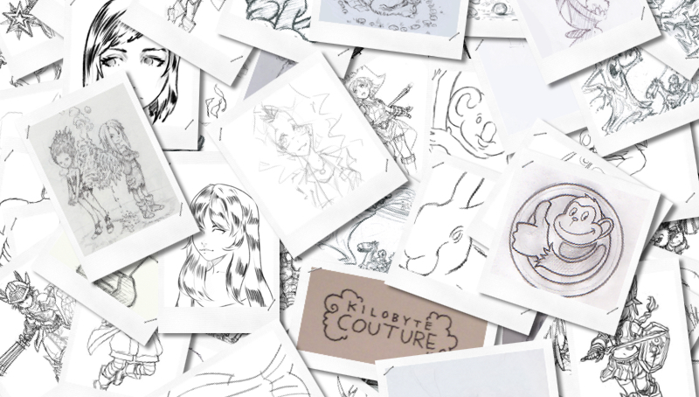
A Benchmark for Rough Sketch Cleanup
Chuan Yan CraGL, George Mason University
David Vanderhaeghe IRIT CNRS, Université de Toulouse
Yotam Gingold CraGL, George Mason University

Slide 3
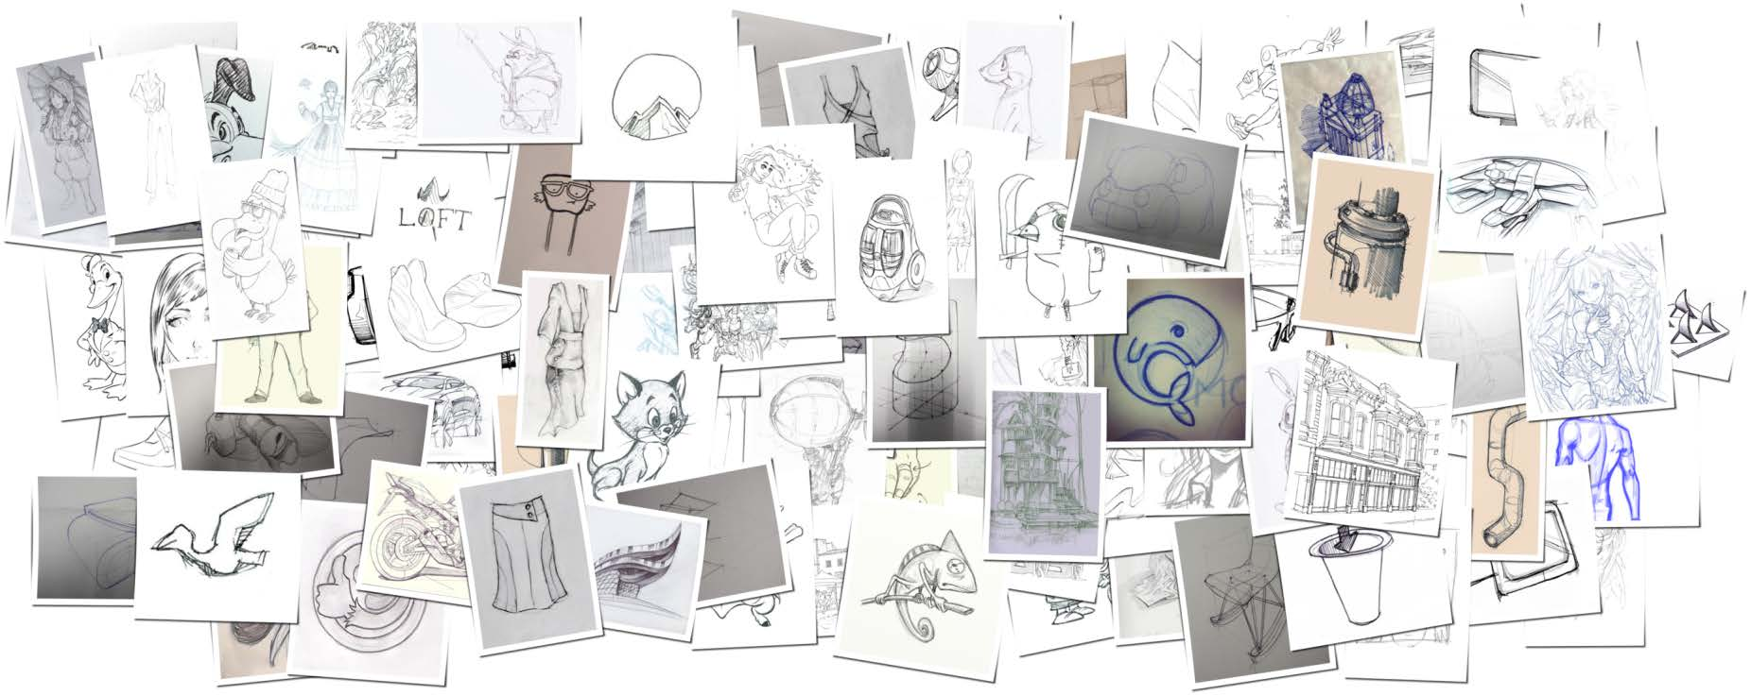
The Design Process
Notes:
Image source: The Process of Design Squiggle by Damien Newman, thedesignsquiggle.com, https://thedesignsquiggle.com/Download
License: a Creative Commons Attribution-No Derivative Works 3.0 United States License
Sketching is a process where an artist draw his idea. This process usually starts with very rough sketch, then it is refined to obtain a clear line drawing. We can model the sketching process with a curve from chase to stability. Where rough and messy sketches converge to a clear drawing.

Slide 4
The Design Process
Chaotic & Easy
Neat & Costly
The design squiggle: Damien Newman (CC-BY-ND 3.0)
Notes:
Image source: The Process of Design Squiggle by Damien Newman, thedesignsquiggle.com, https://thedesignsquiggle.com/Download
License: a Creative Commons Attribution-No Derivative Works 3.0 United States License
Sketching is a process where an artist draw his idea. This process usually starts with very rough sketch, then it is refined to obtain a clear line drawing. We can model the sketching process with a curve from chase to stability. Where rough and messy sketches converge to a clear drawing.

Slide 5
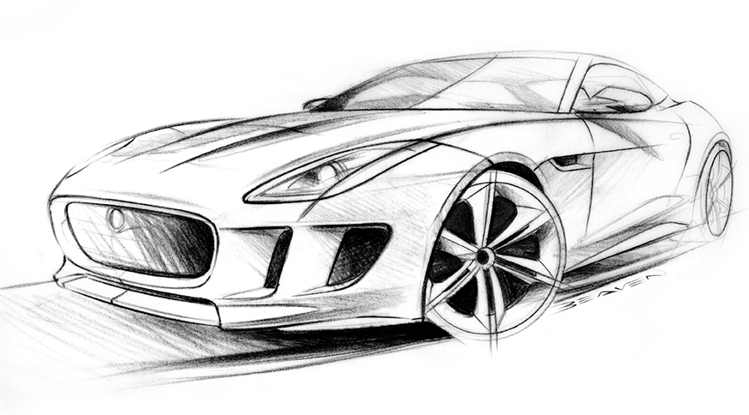
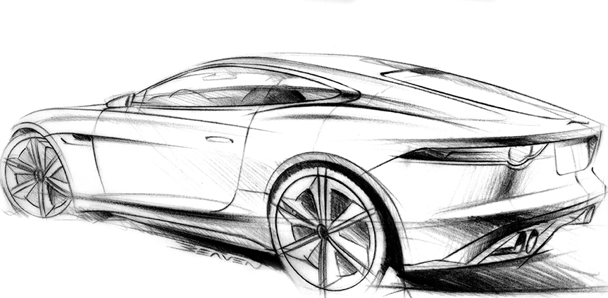
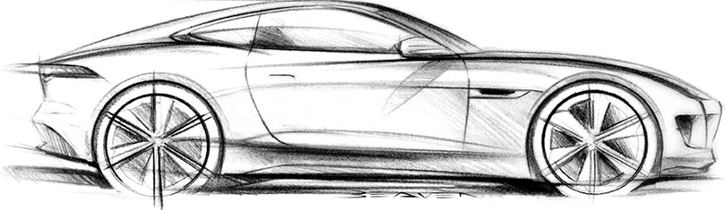
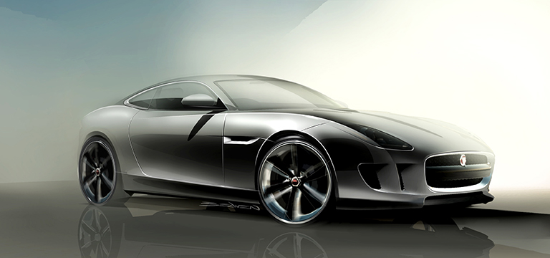
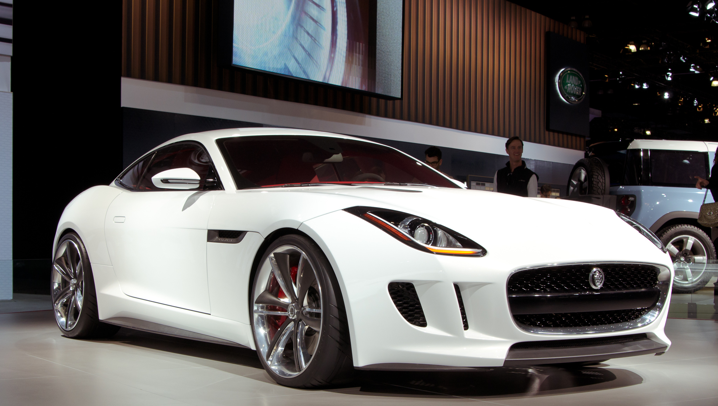
The Design Process
Chaotic & Easy
Neat & Costly
The design squiggle: Damien Newman (CC-BY-ND 3.0), Design works: Jaguar MENA (CC-BY 2.0), Photo: Daremoshiranai (CC-BY-NC 2.0)
Notes:
Image source: The Process of Design Squiggle by Damien Newman, thedesignsquiggle.com, https://thedesignsquiggle.com/Download
License: a Creative Commons Attribution-No Derivative Works 3.0 United States License
Photo source:https://www.flickr.com/photos/daremoshiranai/6429396361/in/photolist-nKMkgm-nHVm9J-nKVq1C-nKERMp-nttnRR-nMKeTk-nKY3Ma-nHVrN9-nttoQp-nKMnpQ-nttgZj-nHVmhj-ntt7FF-nKVCZJ-nttdRL-nKMCds-nKMAXb-nKMqrb-nttrkU-nKXR6e-nHVC5S-nKXPJX-nMKjWX-nKMqiA-nKMqQ7-nHVrGN-ntthfj-nKXPWv-nKXT6M-nttdMi-nttH8p-nHVsp9-nttHcx-nttrY9-nKEPy6-nKY27X-nKVuMS-nttDT8-akjnCB-aN9kxp-akjnzn-aknaX7-akjntt-aknb2A-aknb4u-dX8fjC-dX2zte-dX2zsP-dX2ztx-dX8fm7
Design works: https://www.flickr.com/photos/jaguarcarsmena/6213089905/in/photostream/
Design sketch: https://www.flickr.com/photos/jaguarcarsmena/6213088685/in/photostream/
https://www.flickr.com/photos/jaguarcarsmena/6213603198/in/photostream/
https://www.flickr.com/photos/jaguarcarsmena/6213088537/in/photostream/

Slide 6
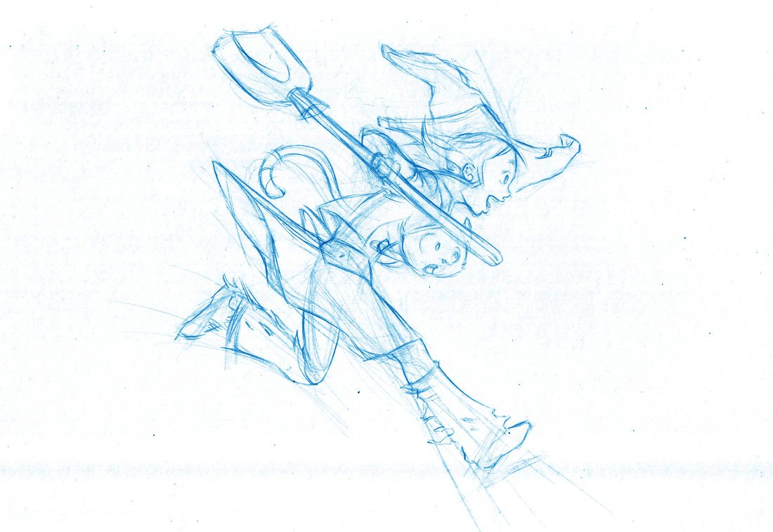
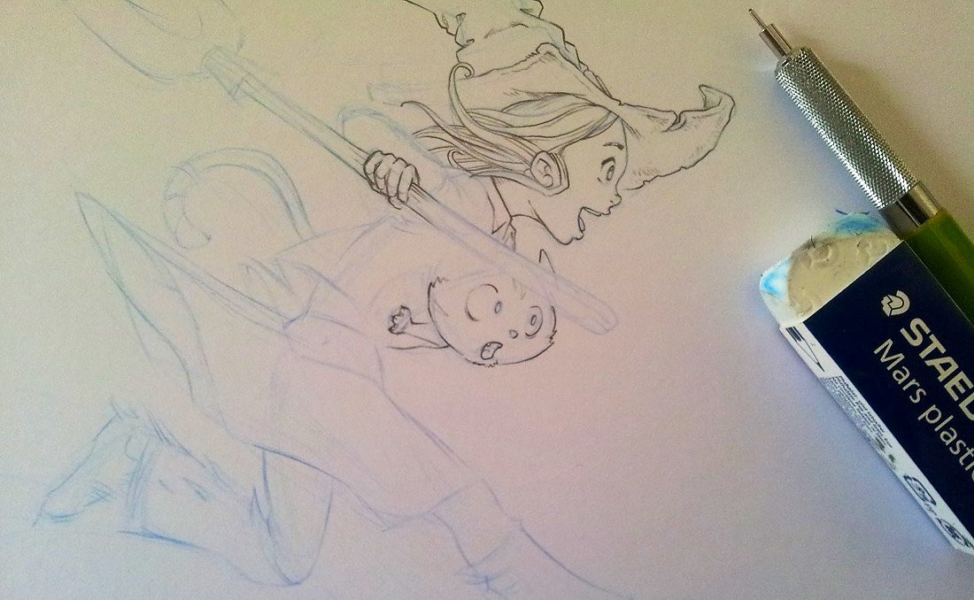
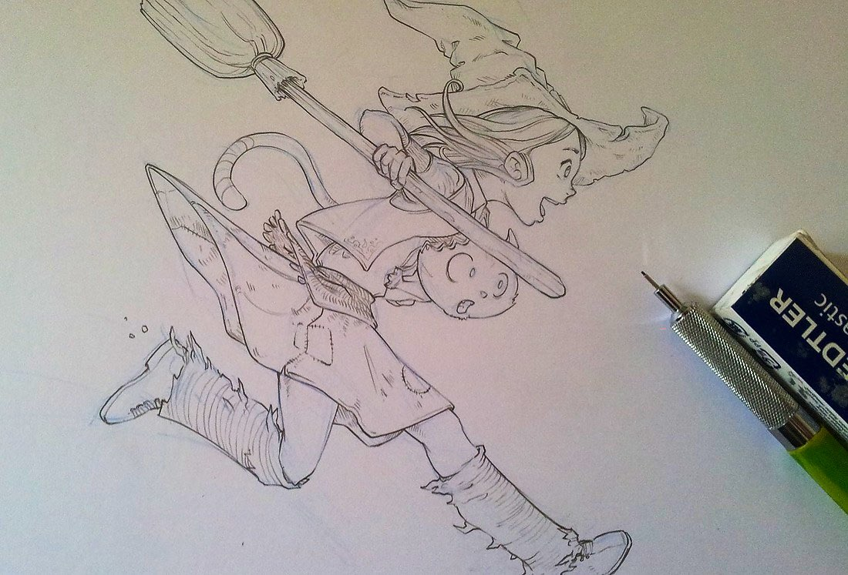
The Design Process
Chaotic
Costly
The design squiggle copyrights: Damien Newman (CC-BY-ND 3.0)
Notes:
Image source: The Process of Design Squiggle by Damien Newman, thedesignsquiggle.com, https://thedesignsquiggle.com/Download
License: a Creative Commons Attribution-No Derivative Works 3.0 United States License
Sketching is a process where an artist draw his idea. This process usually starts with very rough sketch, then it is refined to obtain a clear line drawing. We can model the sketching process with a curve from chase to stability. Where rough and messy sketches converge to a clear drawing.

Slide 7
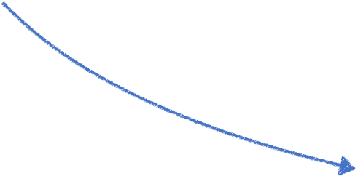
The Design Process
Chaos to stability
Cost
Chaos to stability
Image copyrights: Damien Newman (CC-BY-ND 3.0), David Revoy (CC BY 4.0)
Notes:
Image source: The Process of Design Squiggle by Damien Newman, thedesignsquiggle.com, https://thedesignsquiggle.com/Download
License: a Creative Commons Attribution-No Derivative Works 3.0 United States License
Sketching is a process where an artist draw his idea. This process usually starts with very rough sketch, then it is refined to obtain a clear line drawing. We can model the sketching process with a curve from chase to stability. Where rough and messy sketches converge to a clear drawing.

Slide 8
The Design Process
Chaos to stability
Messiness,
Mistakes
Chaos to stability
Cost of Change
Image copyrights: CC-BY-ND 3.0@Damien Newman
Notes:
Image source: The Process of Design Squiggle by Damien Newman, thedesignsquiggle.com, https://thedesignsquiggle.com/Download
License: a Creative Commons Attribution-No Derivative Works 3.0 United States License
Sketching is a process where an artist draw his idea. This process usually starts with very rough sketch, then it is refined to obtain a clear line drawing. We can model the sketching process with a curve from chase to stability. Where rough and messy sketches converge to a clear drawing.

Slide 9
GAP on this CURve
Conceptual Level
Structural Level
Stroke Level
Done!
Copyright: CC BY 4.0 @ David Revoy, CC-BY-ND 3.0@Damien Newman
Notes:
May be we can hide this slide…?
Image source: https://www.davidrevoy.com/article239/clean-blue-sketch-traditional-line-art-to-color-it-digital-with-in-krita
License: CC BY 4.0 by David Revoy
At the beginning , a sketch is merely a rough concept, and after the artist decide what to draw, then he needs to figure out what the structure of the sketch is, including figure actions and sketch composition. When structural design is done, a stroke level refinement is still necessary. Finally, we get a cleaned sketch which efficiently convey the information, and therefore are the ideal input of many sketch processing algorithms

Slide 10
The Design Process
Conceptual Level
Structural Level
Stroke Level
Done!
Image copyrights: CC BY 4.0 @ David Revoy, CC-BY-ND 3.0@Damien Newman
Notes:
At the beginning , a sketch is merely a rough concept, and after the artist decide what to draw, then he needs to figure out what the structure of the sketch is, including figure actions and sketch composition. When structural design is done, a stroke level refinement is still necessary. Finally, we get a cleaned sketch which efficiently convey the information, and therefore are the ideal input of many sketch processing algorithms

Slide 11
Gap on This Curve
3D Inference
Colorization
Frame Interpolation
Time consuming not Interesting
（；´д｀）ゞ
UI design
Interesting Creative thinking
(๑•̀ㅂ•́)و✧
…
Conceptual Level
Structural Level
Stroke Level
Done!
Image copyrights: CC BY 4.0 @ David Revoy, CC-BY-ND 3.0@Damien Newman
Notes:
Image source: https://www.davidrevoy.com/article239/clean-blue-sketch-traditional-line-art-to-color-it-digital-with-in-krita
License: CC BY 4.0 by David Revoy
Which including sketch to 3d models, automatic colorization, vectorization, interpolate intermediate frames between two key frames, or to generate a user interface, and so on.
However, design a sketch is always interesting but cleaning a sketch is not. And a sketch at the structural level can not be input to those well developed algorithms correctly. Therefore, bridge the gap between them is necessary.

Slide 12
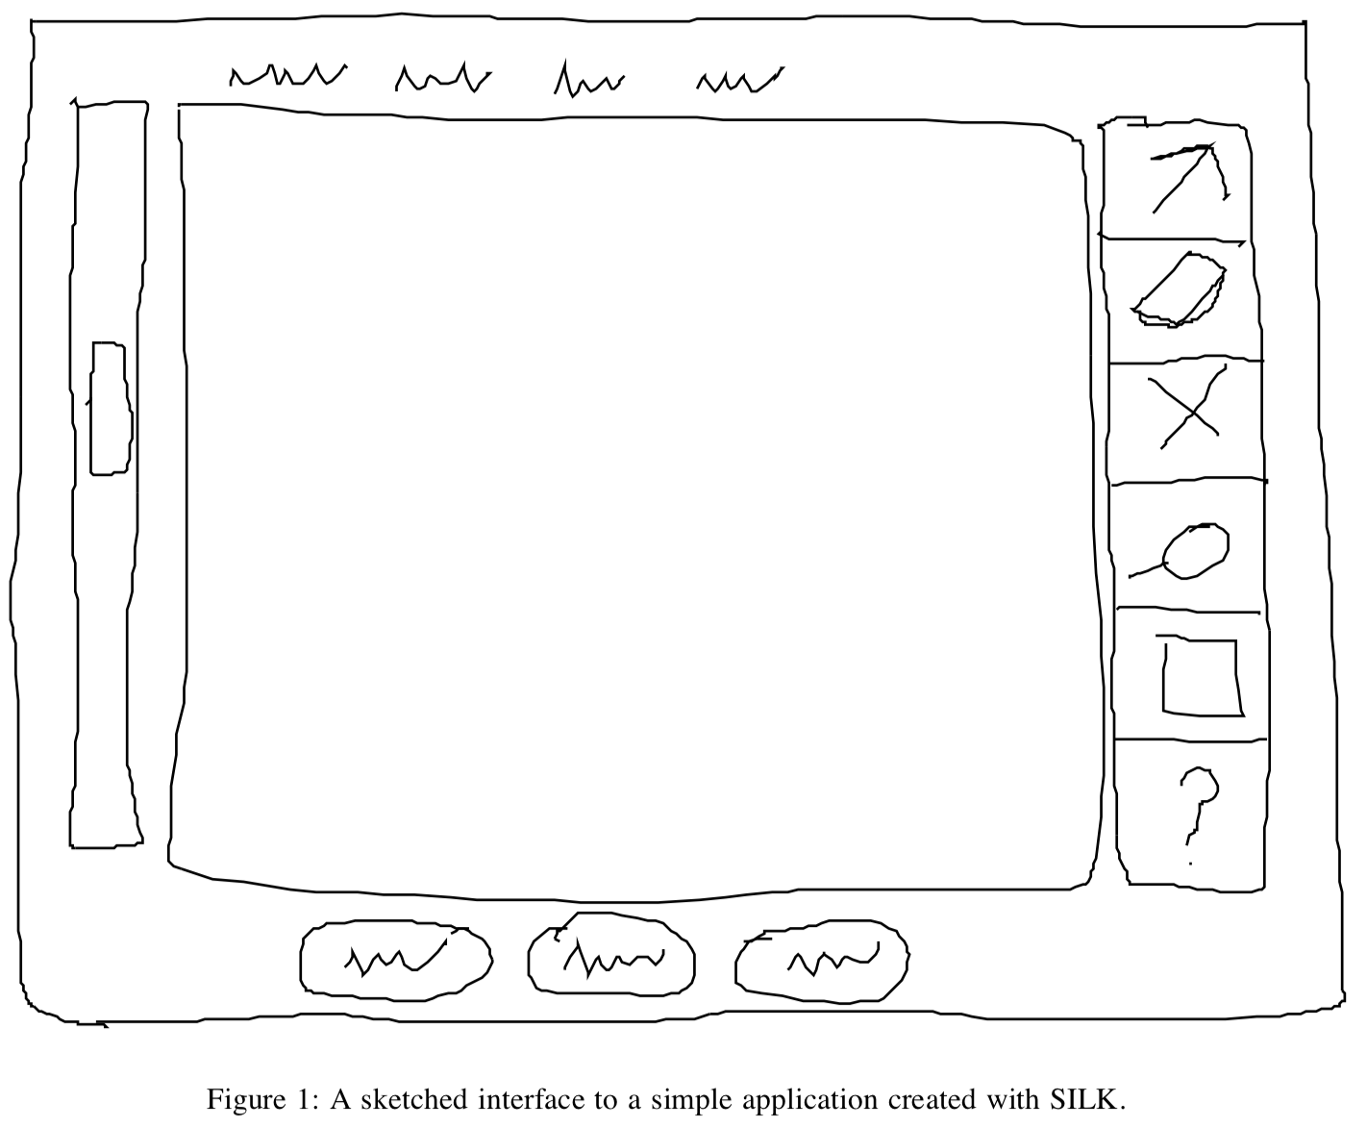
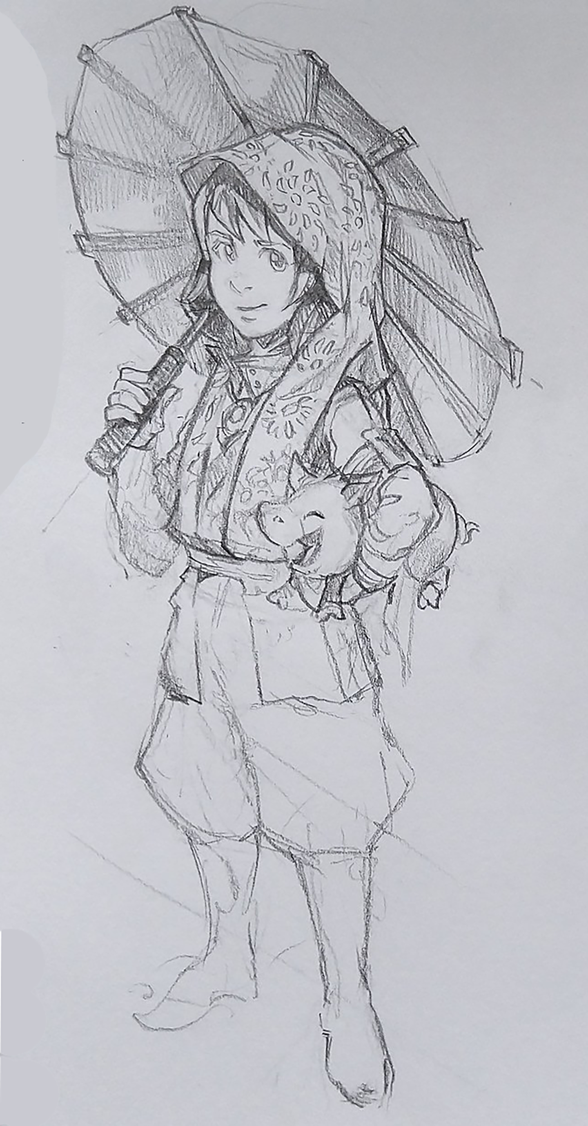
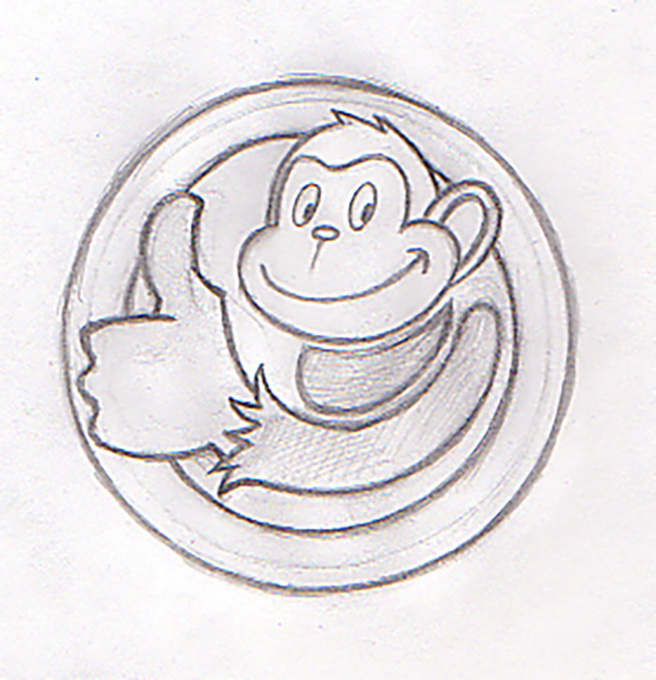
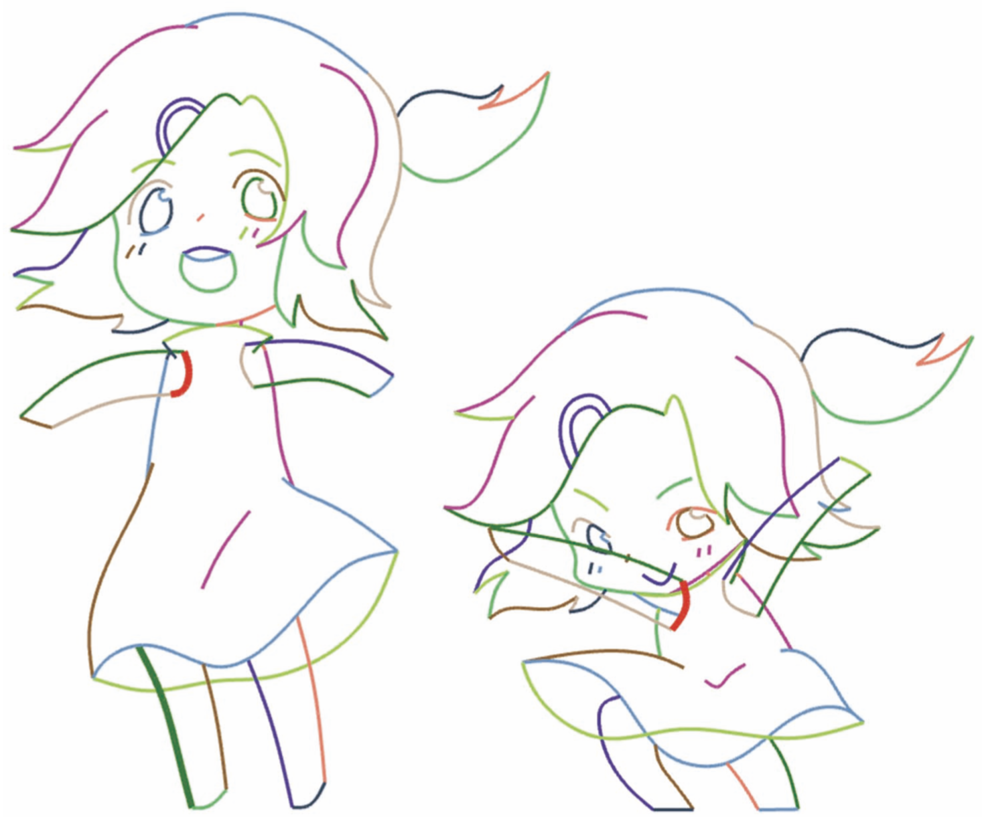
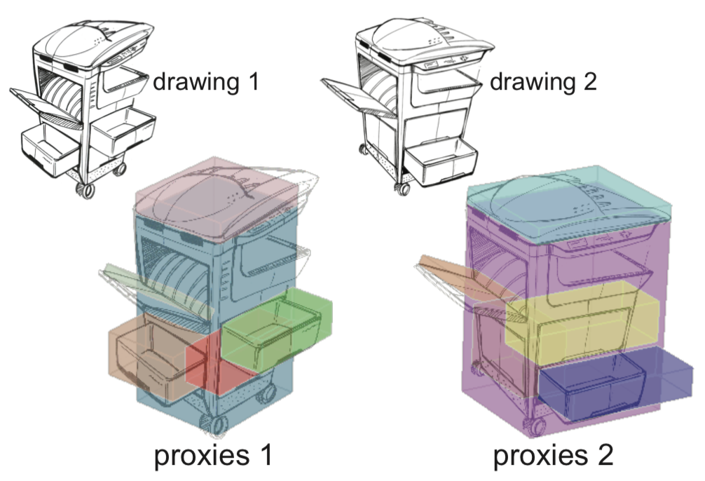
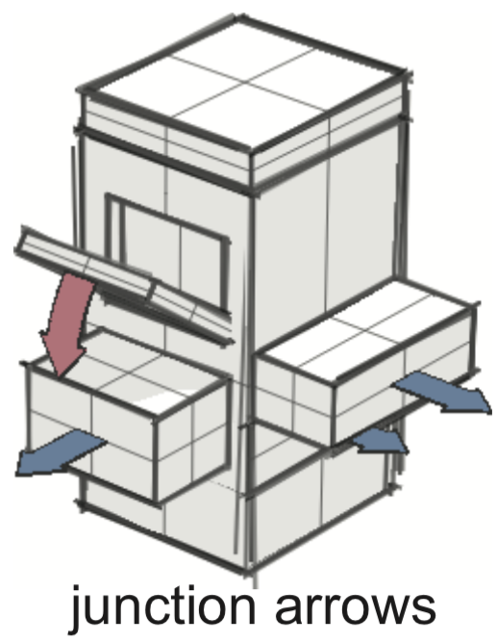
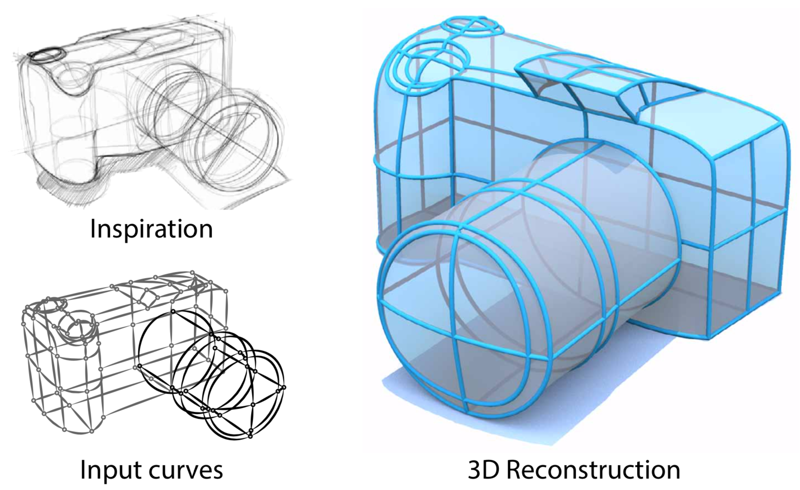
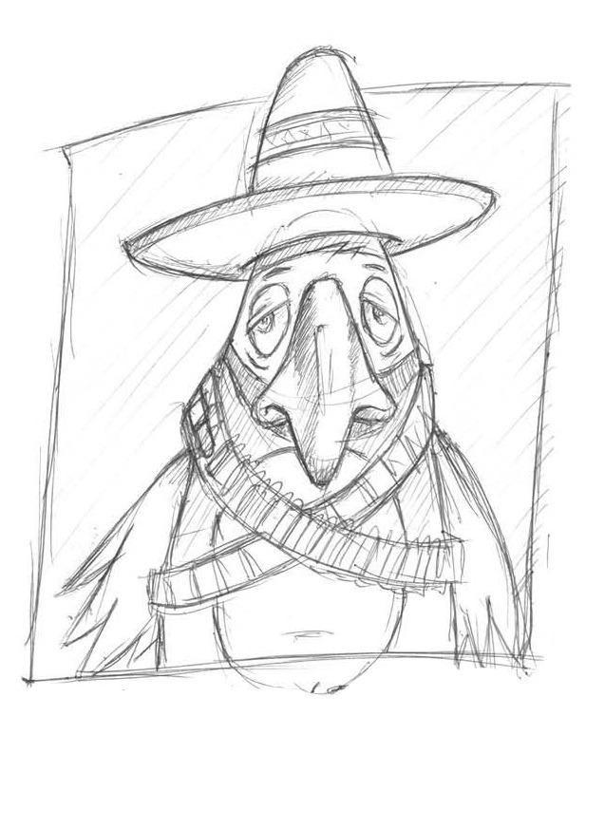
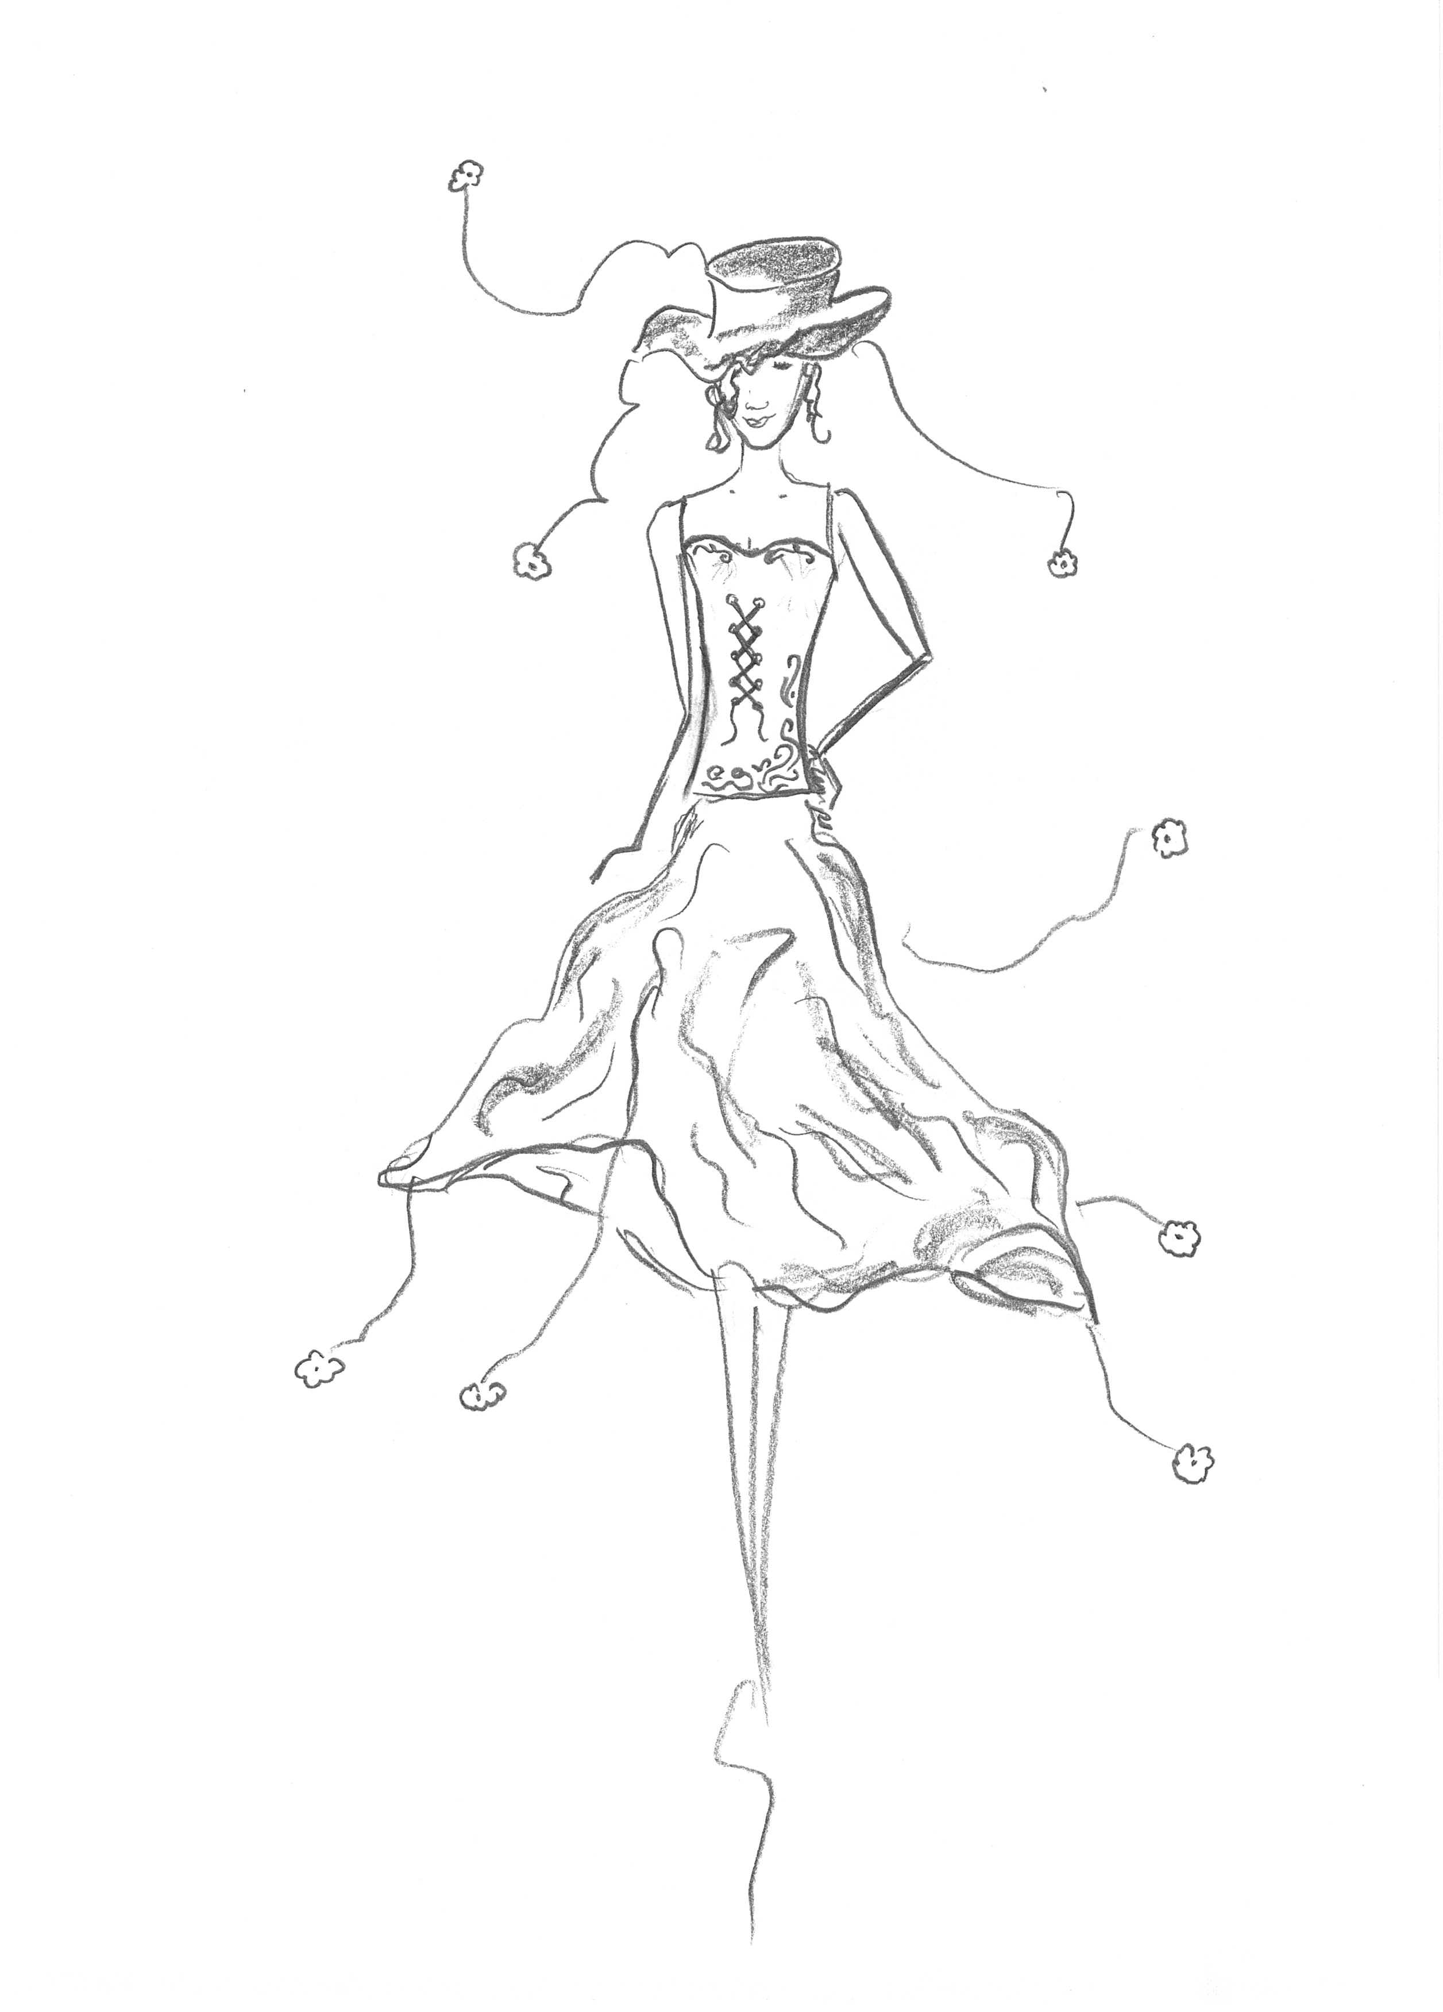
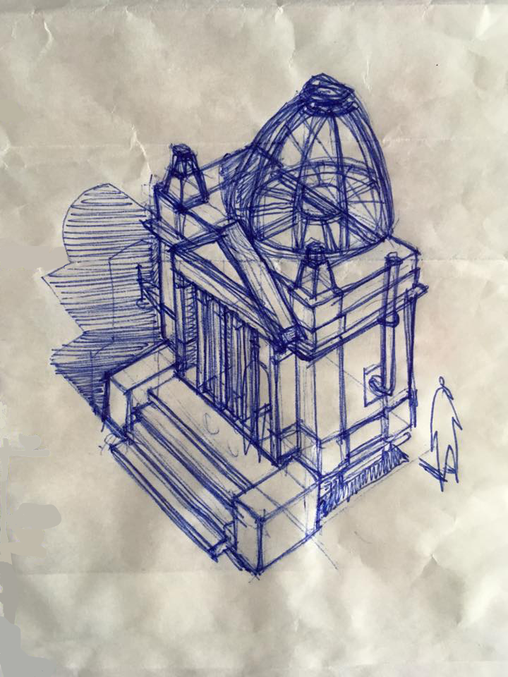
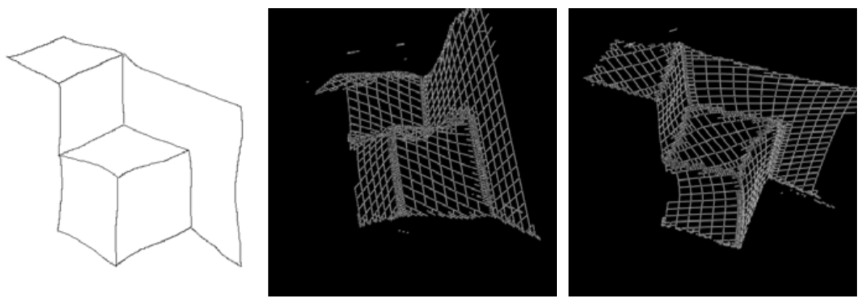
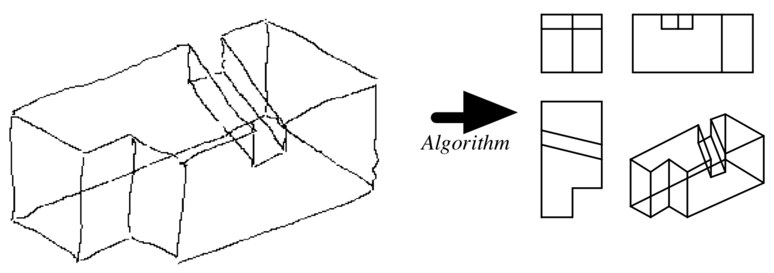
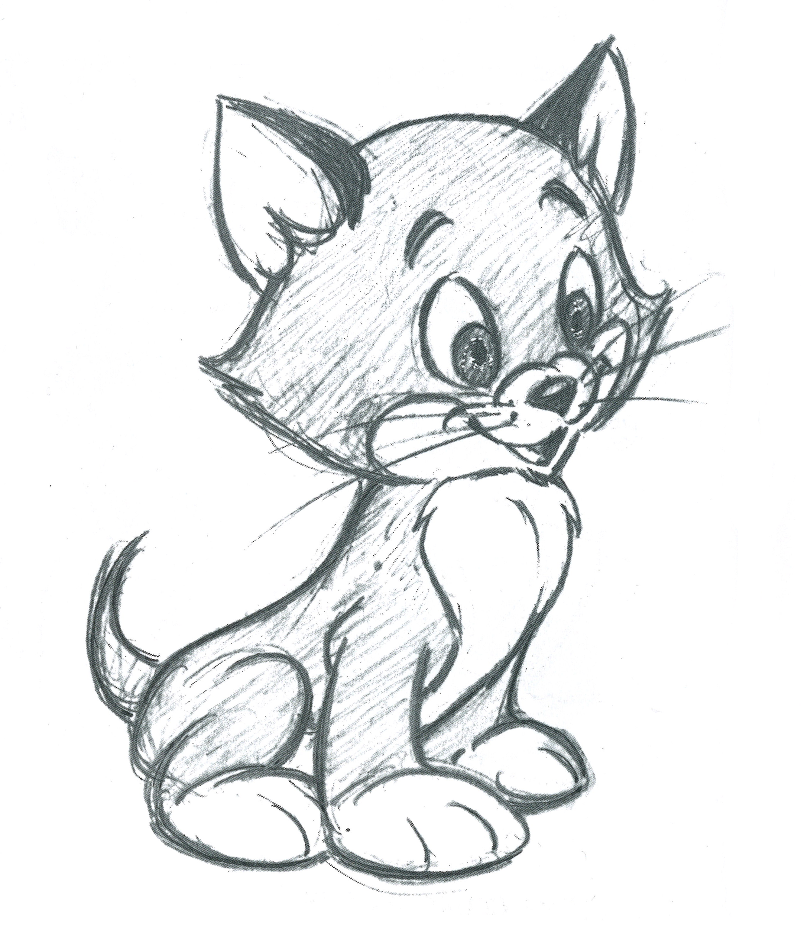
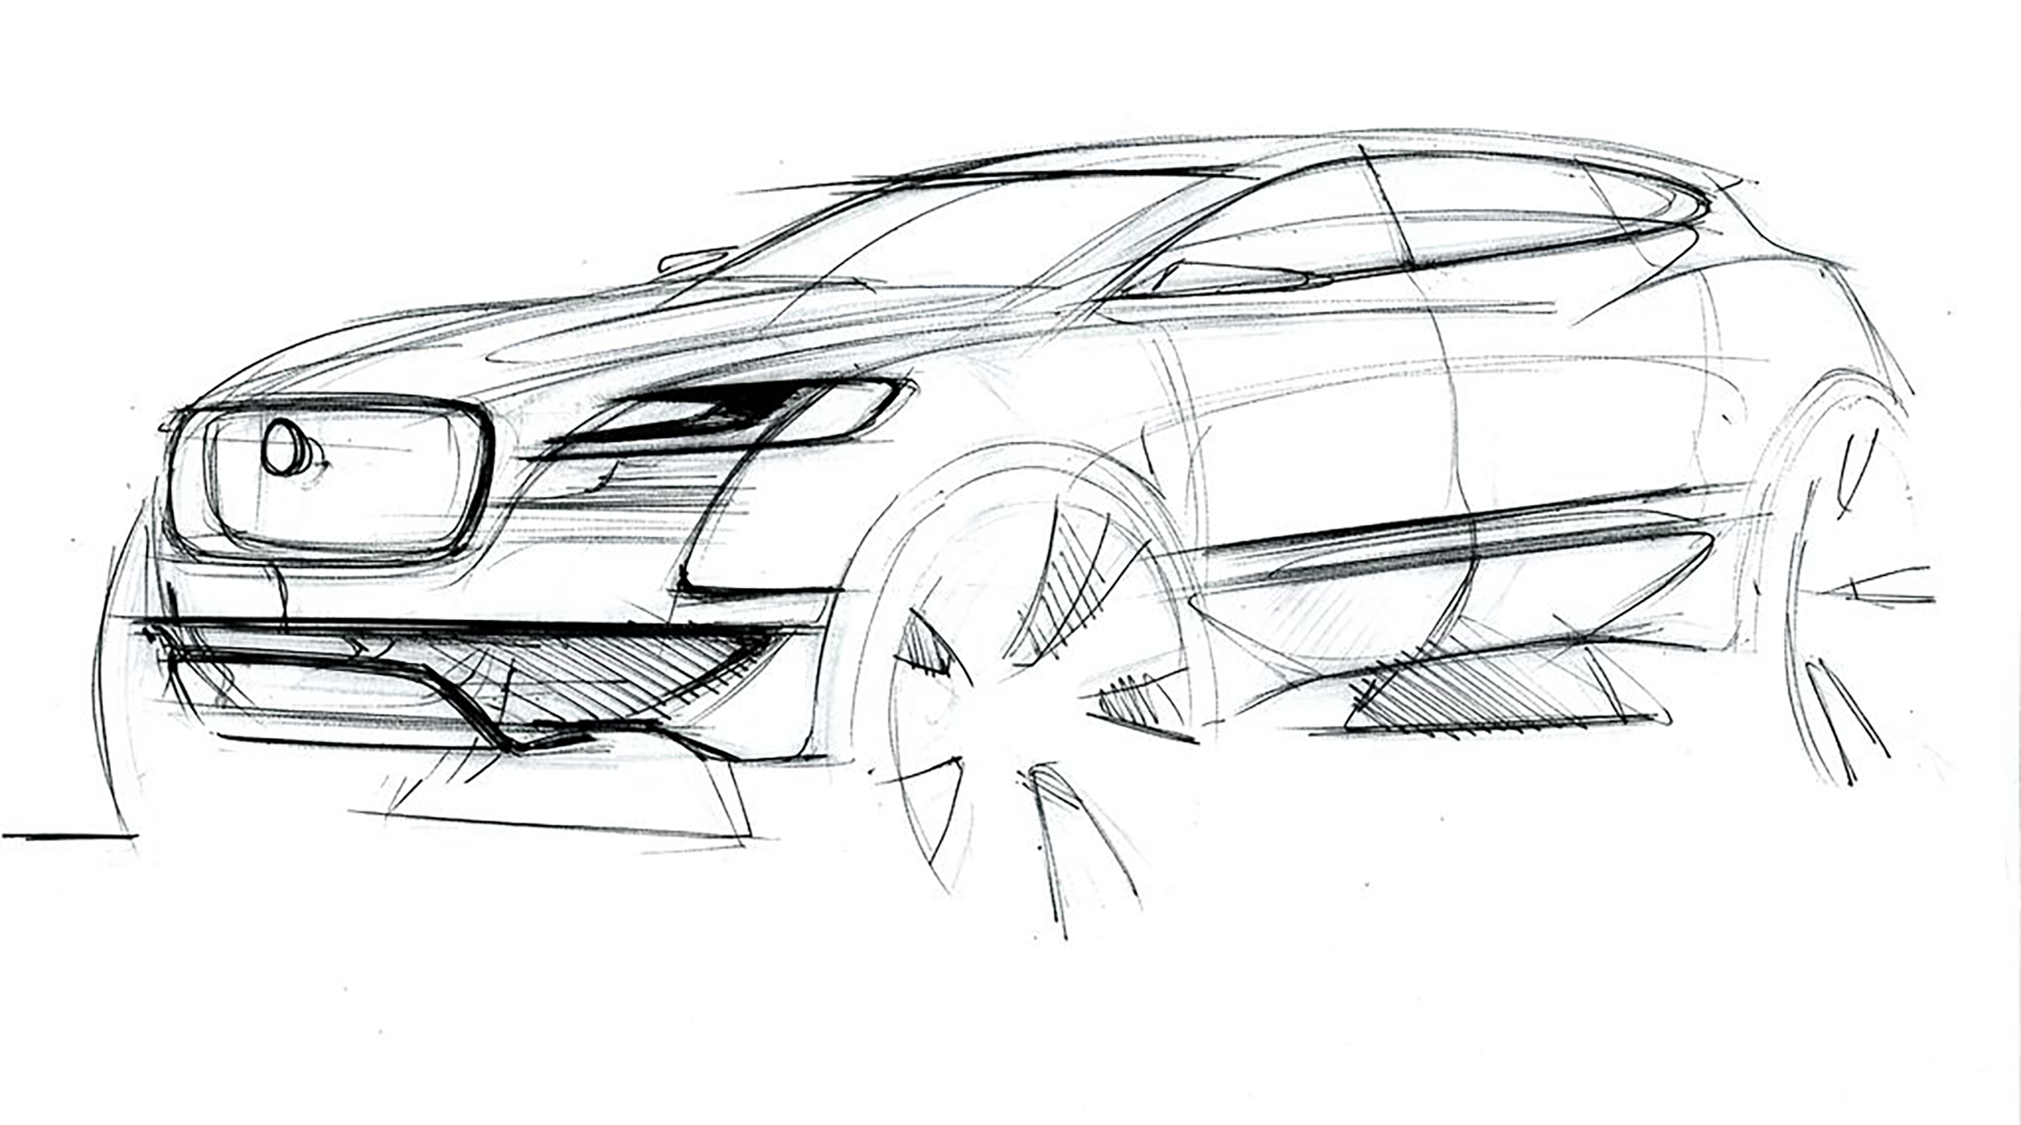
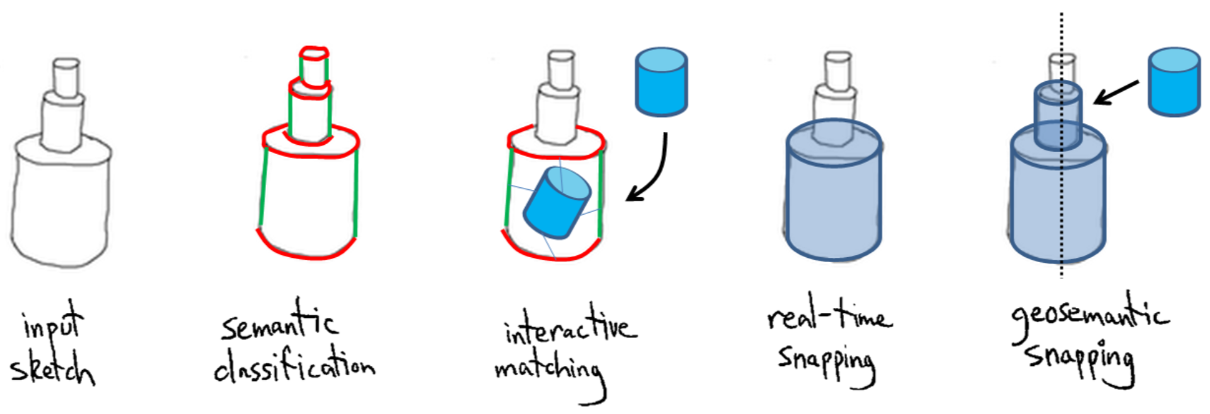
The Design Process
Neatness Gap
SILK [Landay and Myers 1994]
[T. Shao, et al 2013]
FTP-SC [Yang et al 2018]
True2Form [Xu et al 2014]
CrossShade [C. Shao et al 2012]
BetweenIT [Whited et al 2010]
[Kaplan and Cohen 2006]
Decades of sketch
processing research
[Lipson and Shpitalni 1996]
Sketches
The design squiggle: Damien Newman (CC-BY-ND 3.0)
[Shtof et al. 2013]
Notes:
Image source: https://www.davidrevoy.com/article239/clean-blue-sketch-traditional-line-art-to-color-it-digital-with-in-krita
License: CC BY 4.0 by David Revoy
Which including sketch to 3d models, automatic colorization, vectorization, interpolate intermediate frames between two key frames, or to generate a user interface, and so on.
However, design a sketch is always interesting but cleaning a sketch is not. And a sketch at the structural level can not be input to those well developed algorithms correctly. Therefore, bridge the gap between them is necessary.

Slide 13
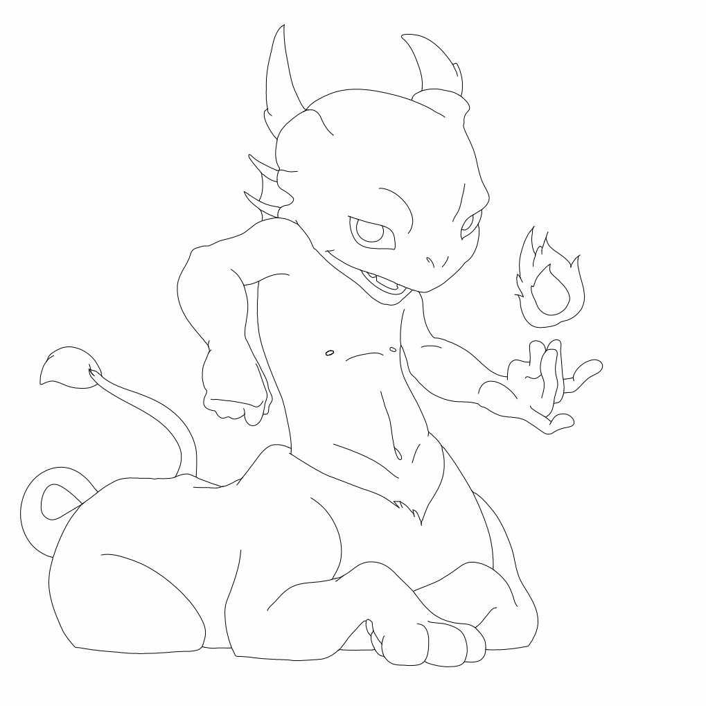
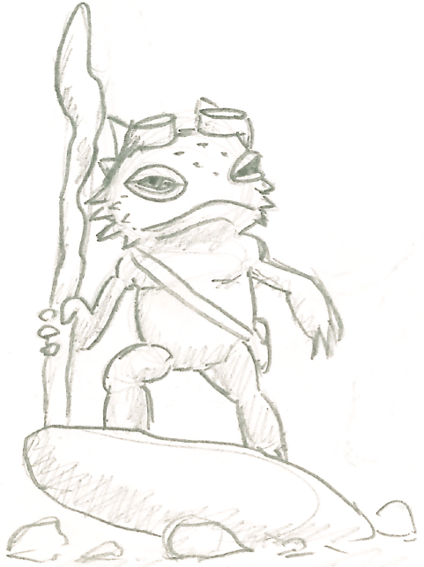
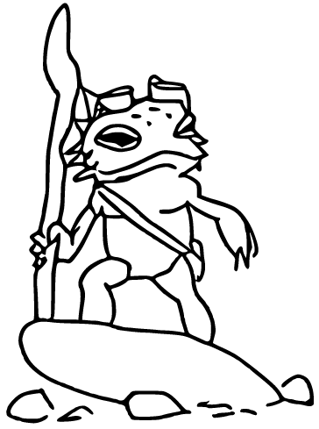
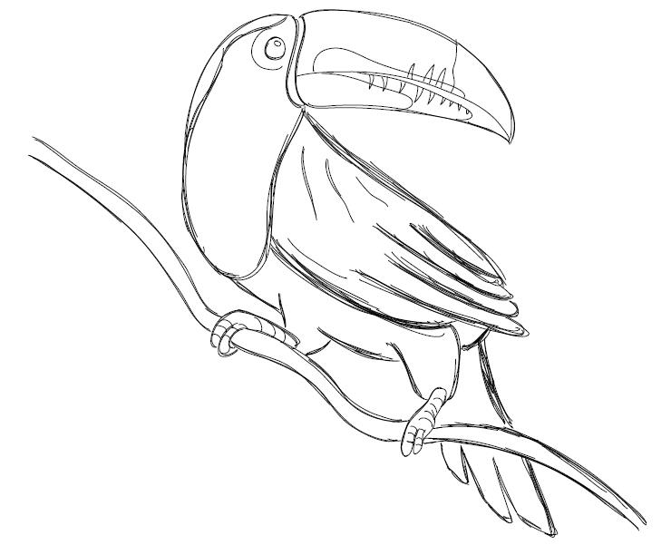
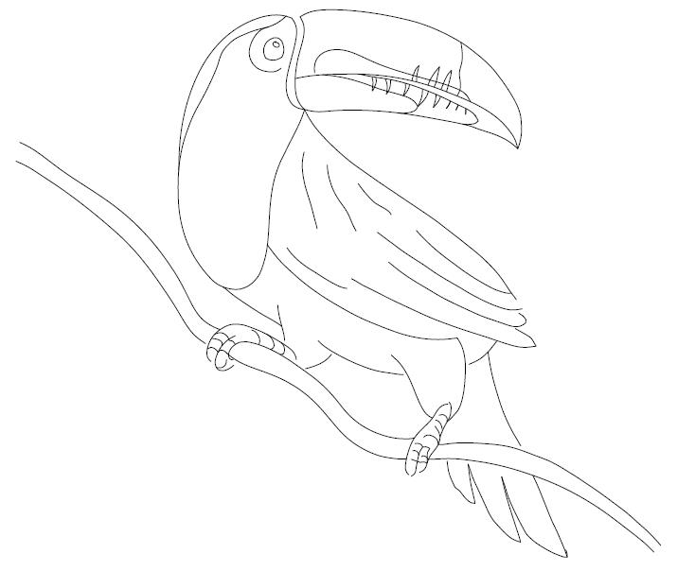
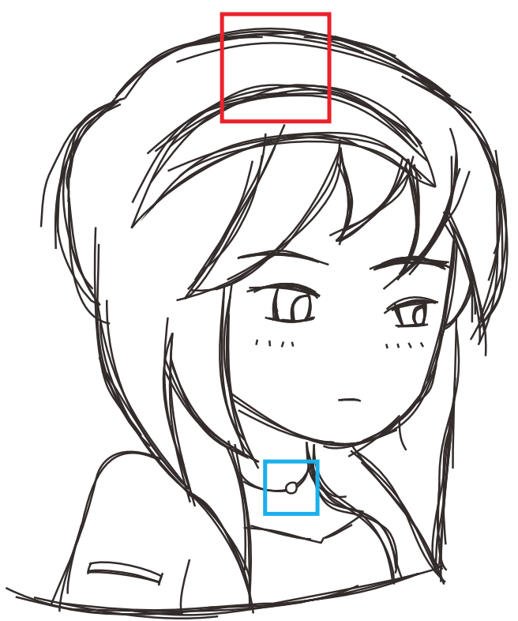
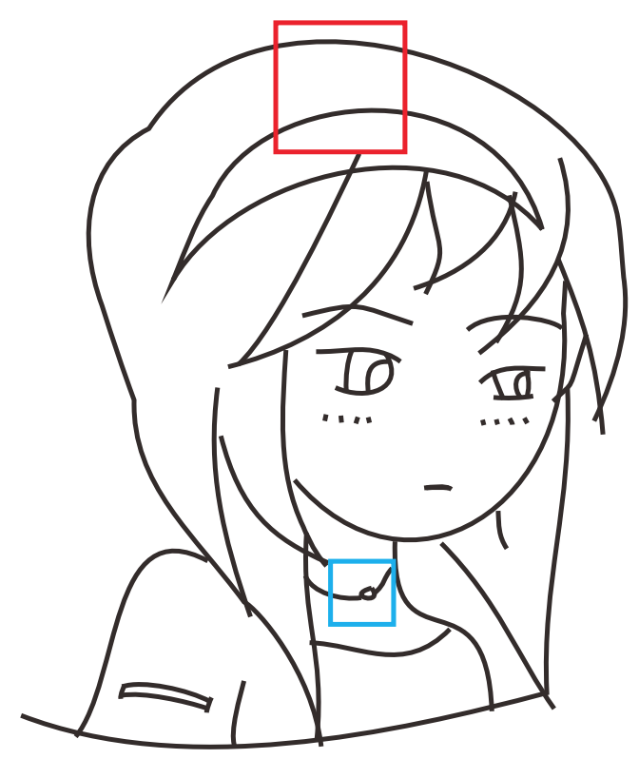
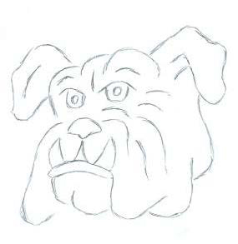
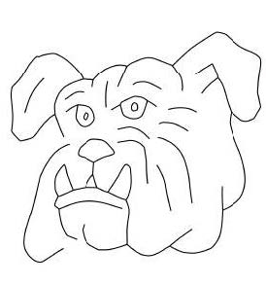
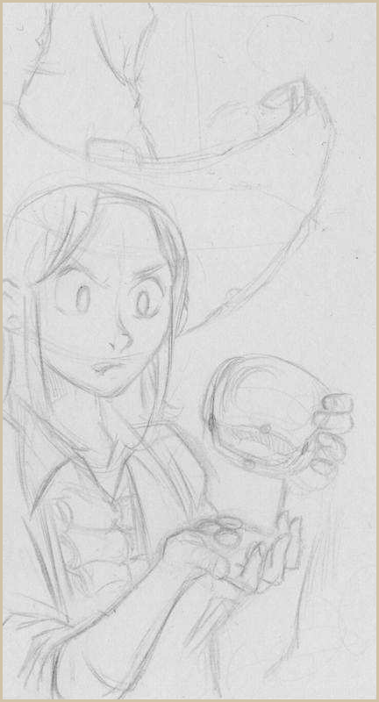
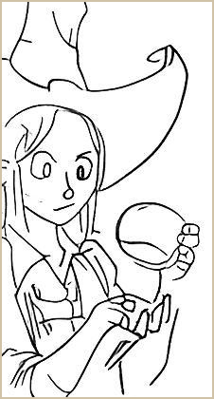
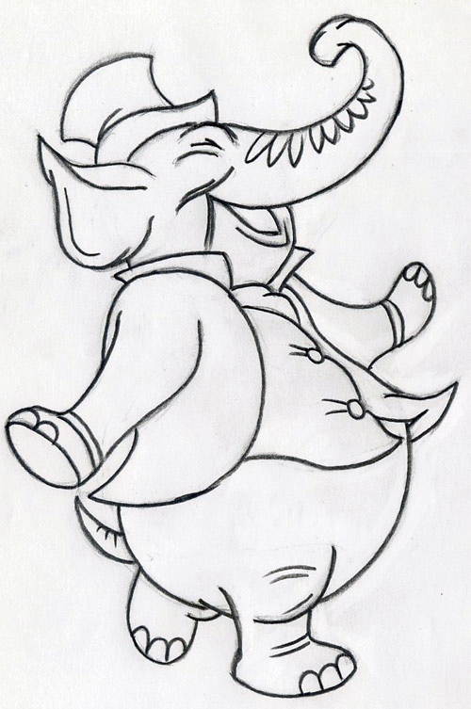
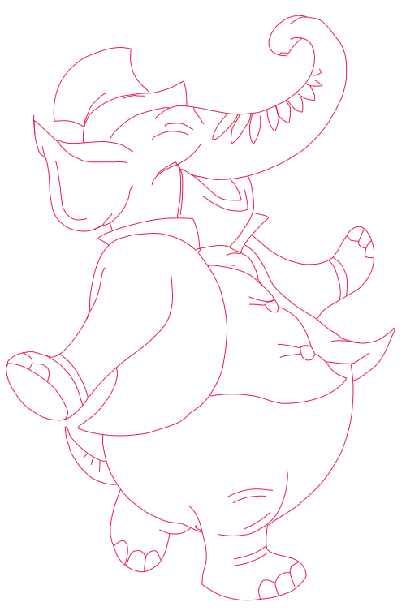
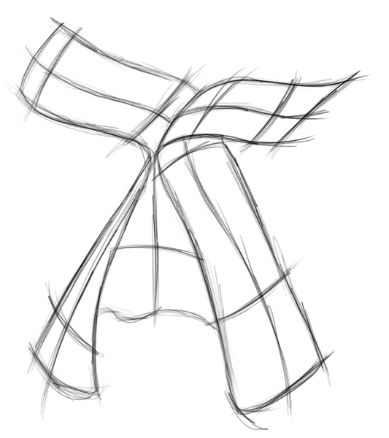
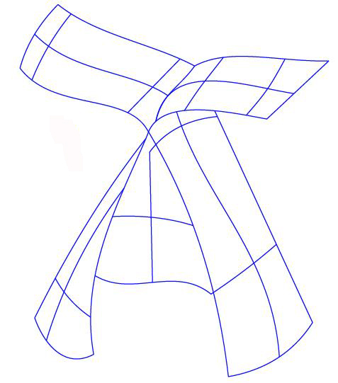
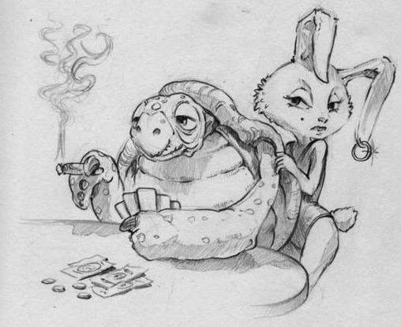
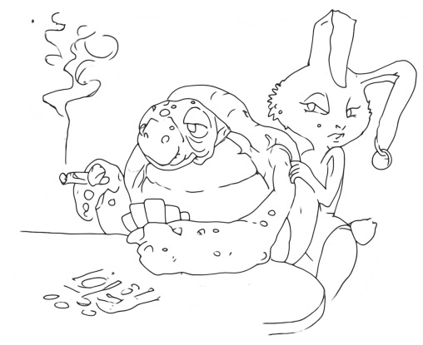
Existing Sketch Cleanup Algorithms
©Enrique Rosales
[Noris et al. 2013]
[Simo-Serra et al. 2018a]
[Liu et al. 2018]
CC-BY-4.0 © David Revoy
©Ivan Huska
[Parakkat et al. 2018]
[Liu et al. 2015]
CC-BY-4.0 © David Revoy
[Favreau et al. 2016]
[Xu et al. 2019]
[Bessmeltsev and Solomon 2019]
[Simo-Serra et al. 2018b]
Notes:
Fortunately, we have many researchers proved that this cleaning process could be done automatically, and there are numbers of algorithms that aim to fill the gap and help artists to focus on creative thinking. However, with more and more algorithms are proposed, we find there are still some problems when trying to apply them in practice

Slide 14
Sketches in the Wild
Messy & ambiguous strokes
Deliberately non-smooth
Texture & shading
Wild sketches are different!
Mostly raster
Messy & ambiguous strokes
Varying stroke thickness & weight
Physical artifacts
Non-shape strokes
Local ambiguity
Global context
Deliberately non-smooth strokes
Many genres
…
Which algorithm works best?
CC-BY-SA-4.0 © Myriam Lasserre
CC BY 4.0 © David Revoy
Global context
Scaffolds
CC-BY-4.0 © David Revoy
Junction closure
Physical artifacts
CC-BY-3.0 © Gregory Laufersweiler
Stroke thickness
CC-BY-SA © Akshay Sharma
Hatching lines
CC-BY-SA © Tinyhouse University
CC-BY-4.0 © Trip Ivey
© Preston Blair
Notes:
First of all, end users may find that the rough sketches in the wild are different with rough sketches in experiment a lot.
Most wild rough sketches are in raster format, they have varying stroke thickness and weights. Many physical artifact are introduced by the way of how users create their rough sketch, such as paper texture backgrounds and environmental lighting. Beside those, rough sketch itself may contains many non-shape strokes such as hatching, shading, scaffold lines. Global context may not be consistent everywhere in the sketch. Even more, artists may use non-smooth stroke, such shaky strokes deliberately. And the last but not the most thing , the sketch content is far more diverse.
On the other hand, users also may wondering which algorithm should they choose?

Slide 15
Sketches in the Wild
Mostly raster
Notes:
First of all, end users may find that the rough sketches in the wild are different with rough sketches in experiment a lot.
Most wild rough sketches are in raster format, they have varying stroke thickness and weights. Many physical artifact are introduced by the way of how users create their rough sketch, such as paper texture backgrounds and environmental lighting. Beside those, rough sketch itself may contains many non-shape strokes such as hatching, shading, scaffold lines. Global context may not be consistent everywhere in the sketch. Even more, artists may use non-smooth stroke, such shaky strokes deliberately. And the last but not the most thing , the sketch content is far more diverse.
On the other hand, users also may wondering which algorithm should they choose?

Slide 16
Sketches in the Wild
Mostly raster
Messy & ambiguous strokes
Messy & ambiguous strokes
Notes:
First of all, end users may find that the rough sketches in the wild are different with rough sketches in experiment a lot.
Most wild rough sketches are in raster format, they have varying stroke thickness and weights. Many physical artifact are introduced by the way of how users create their rough sketch, such as paper texture backgrounds and environmental lighting. Beside those, rough sketch itself may contains many non-shape strokes such as hatching, shading, scaffold lines. Global context may not be consistent everywhere in the sketch. Even more, artists may use non-smooth stroke, such shaky strokes deliberately. And the last but not the most thing , the sketch content is far more diverse.
On the other hand, users also may wondering which algorithm should they choose?

Slide 17
Sketches in the Wild
Mostly raster
Messy & ambiguous strokes
Varying stroke thickness & color
Messy & ambiguous strokes
Stroke thickness
Notes:
First of all, end users may find that the rough sketches in the wild are different with rough sketches in experiment a lot.
Most wild rough sketches are in raster format, they have varying stroke thickness and weights. Many physical artifact are introduced by the way of how users create their rough sketch, such as paper texture backgrounds and environmental lighting. Beside those, rough sketch itself may contains many non-shape strokes such as hatching, shading, scaffold lines. Global context may not be consistent everywhere in the sketch. Even more, artists may use non-smooth stroke, such shaky strokes deliberately. And the last but not the most thing , the sketch content is far more diverse.
On the other hand, users also may wondering which algorithm should they choose?

Slide 18
Sketches in the Wild
Mostly raster
Messy & ambiguous strokes
Varying stroke thickness & color
Physical artifacts
Messy & ambiguous strokes
Stroke thickness
Physical artifacts
Notes:
First of all, end users may find that the rough sketches in the wild are different with rough sketches in experiment a lot.
Most wild rough sketches are in raster format, they have varying stroke thickness and weights. Many physical artifact are introduced by the way of how users create their rough sketch, such as paper texture backgrounds and environmental lighting. Beside those, rough sketch itself may contains many non-shape strokes such as hatching, shading, scaffold lines. Global context may not be consistent everywhere in the sketch. Even more, artists may use non-smooth stroke, such shaky strokes deliberately. And the last but not the most thing , the sketch content is far more diverse.
On the other hand, users also may wondering which algorithm should they choose?

Slide 19
Sketches in the Wild
Texture & shading
Mostly raster
Messy & ambiguous strokes
Varying stroke thickness & color
Physical artifacts
Non-shape strokes
Scaffolds
Messy & ambiguous strokes
Stroke thickness
Physical artifacts
Hatching lines
Notes:
First of all, end users may find that the rough sketches in the wild are different with rough sketches in experiment a lot.
Most wild rough sketches are in raster format, they have varying stroke thickness and weights. Many physical artifact are introduced by the way of how users create their rough sketch, such as paper texture backgrounds and environmental lighting. Beside those, rough sketch itself may contains many non-shape strokes such as hatching, shading, scaffold lines. Global context may not be consistent everywhere in the sketch. Even more, artists may use non-smooth stroke, such shaky strokes deliberately. And the last but not the most thing , the sketch content is far more diverse.
On the other hand, users also may wondering which algorithm should they choose?

Slide 20
Sketches in the Wild
Texture & shading
Mostly raster
Messy & ambiguous strokes
Varying stroke thickness & color
Physical artifacts
Non-shape strokes
Local ambiguity
Scaffolds
Messy & ambiguous strokes
Junction closure
Stroke thickness
Physical artifacts
Hatching lines
Notes:
First of all, end users may find that the rough sketches in the wild are different with rough sketches in experiment a lot.
Most wild rough sketches are in raster format, they have varying stroke thickness and weights. Many physical artifact are introduced by the way of how users create their rough sketch, such as paper texture backgrounds and environmental lighting. Beside those, rough sketch itself may contains many non-shape strokes such as hatching, shading, scaffold lines. Global context may not be consistent everywhere in the sketch. Even more, artists may use non-smooth stroke, such shaky strokes deliberately. And the last but not the most thing , the sketch content is far more diverse.
On the other hand, users also may wondering which algorithm should they choose?

Slide 21
Sketches in the Wild
Texture & shading
Global change
Mostly raster
Messy & ambiguous strokes
Varying stroke thickness & color
Physical artifacts
Non-shape strokes
Local ambiguity
Global change
Scaffolds
Messy & ambiguous strokes
Junction closure
Stroke thickness
Physical artifacts
Hatching lines
Notes:
First of all, end users may find that the rough sketches in the wild are different with rough sketches in experiment a lot.
Most wild rough sketches are in raster format, they have varying stroke thickness and weights. Many physical artifact are introduced by the way of how users create their rough sketch, such as paper texture backgrounds and environmental lighting. Beside those, rough sketch itself may contains many non-shape strokes such as hatching, shading, scaffold lines. Global context may not be consistent everywhere in the sketch. Even more, artists may use non-smooth stroke, such shaky strokes deliberately. And the last but not the most thing , the sketch content is far more diverse.
On the other hand, users also may wondering which algorithm should they choose?

Slide 22
Sketches in the Wild
Texture & shading
Global change
Mostly raster
Messy & ambiguous strokes
Varying stroke thickness & color
Physical artifacts
Non-shape strokes
Local ambiguity
Global changes
Deliberately non-smooth strokes
Deliberately non-smooth
Scaffolds
Messy & ambiguous strokes
Junction closure
Stroke thickness
Physical artifacts
Hatching lines
Notes:
First of all, end users may find that the rough sketches in the wild are different with rough sketches in experiment a lot.
Most wild rough sketches are in raster format, they have varying stroke thickness and weights. Many physical artifact are introduced by the way of how users create their rough sketch, such as paper texture backgrounds and environmental lighting. Beside those, rough sketch itself may contains many non-shape strokes such as hatching, shading, scaffold lines. Global context may not be consistent everywhere in the sketch. Even more, artists may use non-smooth stroke, such shaky strokes deliberately. And the last but not the most thing , the sketch content is far more diverse.
On the other hand, users also may wondering which algorithm should they choose?

Slide 23
Sketches in the Wild
Texture & shading
Global change
Mostly raster
Messy & ambiguous strokes
Varying stroke thickness & color
Physical artifacts
Non-shape strokes
Local ambiguity
Global changes
Deliberately non-smooth strokes
Many genres
Deliberately non-smooth
Scaffolds
Messy & ambiguous strokes
Junction closure
Stroke thickness
Physical artifacts
Hatching lines
Notes:
First of all, end users may find that the rough sketches in the wild are different with rough sketches in experiment a lot.
Most wild rough sketches are in raster format, they have varying stroke thickness and weights. Many physical artifact are introduced by the way of how users create their rough sketch, such as paper texture backgrounds and environmental lighting. Beside those, rough sketch itself may contains many non-shape strokes such as hatching, shading, scaffold lines. Global context may not be consistent everywhere in the sketch. Even more, artists may use non-smooth stroke, such shaky strokes deliberately. And the last but not the most thing , the sketch content is far more diverse.
On the other hand, users also may wondering which algorithm should they choose?

Slide 24
Sketches in the Wild
Texture & shading
Global change
Mostly raster
Messy & ambiguous strokes
Varying stroke thickness & color
Physical artifacts
Non-shape strokes
Local ambiguity
Global changes
Deliberately non-smooth strokes
Many genres
Which algorithm works best?
Deliberately non-smooth
Scaffolds
Messy & ambiguous strokes
Junction closure
Stroke thickness
Physical artifacts
Hatching lines
Notes:
First of all, end users may find that the rough sketches in the wild are different with rough sketches in experiment a lot.
Most wild rough sketches are in raster format, they have varying stroke thickness and weights. Many physical artifact are introduced by the way of how users create their rough sketch, such as paper texture backgrounds and environmental lighting. Beside those, rough sketch itself may contains many non-shape strokes such as hatching, shading, scaffold lines. Global context may not be consistent everywhere in the sketch. Even more, artists may use non-smooth stroke, such shaky strokes deliberately. And the last but not the most thing , the sketch content is far more diverse.
On the other hand, users also may wondering which algorithm should they choose?

Slide 25
Ideal Cleaned Sketch
Texture & shading
Global change
Deliberately non-smooth
Scaffolds
Messy & ambiguous strokes
Junction closure
Stroke thickness
Physical artifacts
Hatching lines
Notes:
First of all, end users may find that the rough sketches in the wild are different with rough sketches in experiment a lot.
Most wild rough sketches are in raster format, they have varying stroke thickness and weights. Many physical artifact are introduced by the way of how users create their rough sketch, such as paper texture backgrounds and environmental lighting. Beside those, rough sketch itself may contains many non-shape strokes such as hatching, shading, scaffold lines. Global context may not be consistent everywhere in the sketch. Even more, artists may use non-smooth stroke, such shaky strokes deliberately. And the last but not the most thing , the sketch content is far more diverse.
On the other hand, users also may wondering which algorithm should they choose?

Slide 26
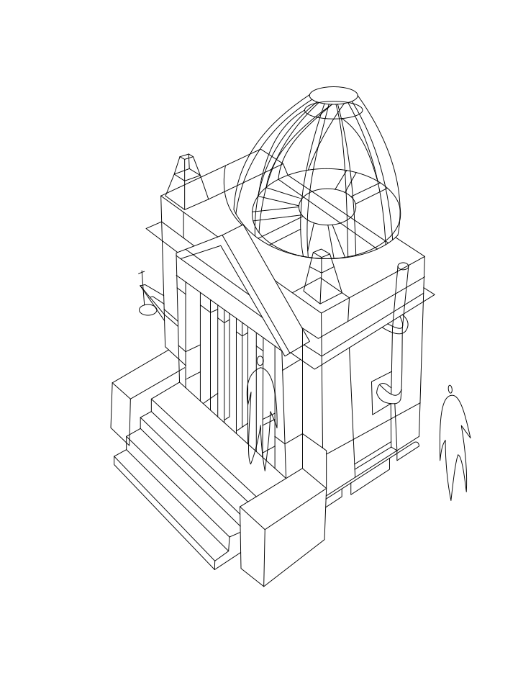
Ideal Cleaned Sketch
Texture & shading
Global change
Consolidate rough strokes
Messy & ambiguous strokes
Physical artifacts
Deliberately non-smooth
Scaffolds
Messy & ambiguous strokes
Junction closure
Stroke thickness
Physical artifacts
Hatching lines
Notes:
First of all, end users may find that the rough sketches in the wild are different with rough sketches in experiment a lot.
Most wild rough sketches are in raster format, they have varying stroke thickness and weights. Many physical artifact are introduced by the way of how users create their rough sketch, such as paper texture backgrounds and environmental lighting. Beside those, rough sketch itself may contains many non-shape strokes such as hatching, shading, scaffold lines. Global context may not be consistent everywhere in the sketch. Even more, artists may use non-smooth stroke, such shaky strokes deliberately. And the last but not the most thing , the sketch content is far more diverse.
On the other hand, users also may wondering which algorithm should they choose?

Slide 27
Ideal Cleaned Sketch
Texture & shading
Global change
Consolidate rough strokes
Messy & ambiguous strokes
Physical artifacts
Identify and separate non-shape strokes
Deliberately non-smooth
Scaffolds
Messy & ambiguous strokes
Junction closure
Stroke thickness
Physical artifacts
Hatching lines
Notes:
First of all, end users may find that the rough sketches in the wild are different with rough sketches in experiment a lot.
Most wild rough sketches are in raster format, they have varying stroke thickness and weights. Many physical artifact are introduced by the way of how users create their rough sketch, such as paper texture backgrounds and environmental lighting. Beside those, rough sketch itself may contains many non-shape strokes such as hatching, shading, scaffold lines. Global context may not be consistent everywhere in the sketch. Even more, artists may use non-smooth stroke, such shaky strokes deliberately. And the last but not the most thing , the sketch content is far more diverse.
On the other hand, users also may wondering which algorithm should they choose?

Slide 28
Ideal Cleaned Sketch
Texture & shading
Global change
Consolidate rough strokes
Messy & ambiguous strokes
Physical artifacts
Identify and separate non-shape strokes
Close junctions
Deliberately non-smooth
Scaffolds
Messy & ambiguous strokes
Junction closure
Stroke thickness
Physical artifacts
Hatching lines
Notes:
First of all, end users may find that the rough sketches in the wild are different with rough sketches in experiment a lot.
Most wild rough sketches are in raster format, they have varying stroke thickness and weights. Many physical artifact are introduced by the way of how users create their rough sketch, such as paper texture backgrounds and environmental lighting. Beside those, rough sketch itself may contains many non-shape strokes such as hatching, shading, scaffold lines. Global context may not be consistent everywhere in the sketch. Even more, artists may use non-smooth stroke, such shaky strokes deliberately. And the last but not the most thing , the sketch content is far more diverse.
On the other hand, users also may wondering which algorithm should they choose?

Slide 29
Ideal Cleaned Sketch
Texture & shading
Global change
Consolidate rough strokes
Messy & ambiguous strokes
Physical artifacts
Identify and separate non-shape strokes
Close junctions
Retain
Stroke thickness & color
Deliberately non-smooth
Scaffolds
Messy & ambiguous strokes
Junction closure
Stroke thickness
Physical artifacts
Hatching lines
Notes:
First of all, end users may find that the rough sketches in the wild are different with rough sketches in experiment a lot.
Most wild rough sketches are in raster format, they have varying stroke thickness and weights. Many physical artifact are introduced by the way of how users create their rough sketch, such as paper texture backgrounds and environmental lighting. Beside those, rough sketch itself may contains many non-shape strokes such as hatching, shading, scaffold lines. Global context may not be consistent everywhere in the sketch. Even more, artists may use non-smooth stroke, such shaky strokes deliberately. And the last but not the most thing , the sketch content is far more diverse.
On the other hand, users also may wondering which algorithm should they choose?

Slide 30
Ideal Cleaned Sketch
Texture & shading
Global change
Consolidate rough strokes
Messy & ambiguous strokes
Physical artifacts
Identify and separate non-shape strokes
Close junctions
Retain
Stroke thickness & color
Deliberately non-smooth
Deliberately non-smooth
Scaffolds
Messy & ambiguous strokes
Junction closure
Stroke thickness
Physical artifacts
Hatching lines
Notes:
First of all, end users may find that the rough sketches in the wild are different with rough sketches in experiment a lot.
Most wild rough sketches are in raster format, they have varying stroke thickness and weights. Many physical artifact are introduced by the way of how users create their rough sketch, such as paper texture backgrounds and environmental lighting. Beside those, rough sketch itself may contains many non-shape strokes such as hatching, shading, scaffold lines. Global context may not be consistent everywhere in the sketch. Even more, artists may use non-smooth stroke, such shaky strokes deliberately. And the last but not the most thing , the sketch content is far more diverse.
On the other hand, users also may wondering which algorithm should they choose?

Slide 31
Ideal Cleaned Sketch
Texture & shading
Global change
Consolidate rough strokes
Messy & ambiguous strokes
Physical artifacts
Identify and separate non-shape strokes
Close junctions
Retain
Stroke thickness & color
Deliberately non-smooth
Global change (out of scope)
Deliberately non-smooth
Scaffolds
Messy & ambiguous strokes
Junction closure
Stroke thickness
Physical artifacts
Hatching lines
Notes:
First of all, end users may find that the rough sketches in the wild are different with rough sketches in experiment a lot.
Most wild rough sketches are in raster format, they have varying stroke thickness and weights. Many physical artifact are introduced by the way of how users create their rough sketch, such as paper texture backgrounds and environmental lighting. Beside those, rough sketch itself may contains many non-shape strokes such as hatching, shading, scaffold lines. Global context may not be consistent everywhere in the sketch. Even more, artists may use non-smooth stroke, such shaky strokes deliberately. And the last but not the most thing , the sketch content is far more diverse.
On the other hand, users also may wondering which algorithm should they choose?

Slide 32
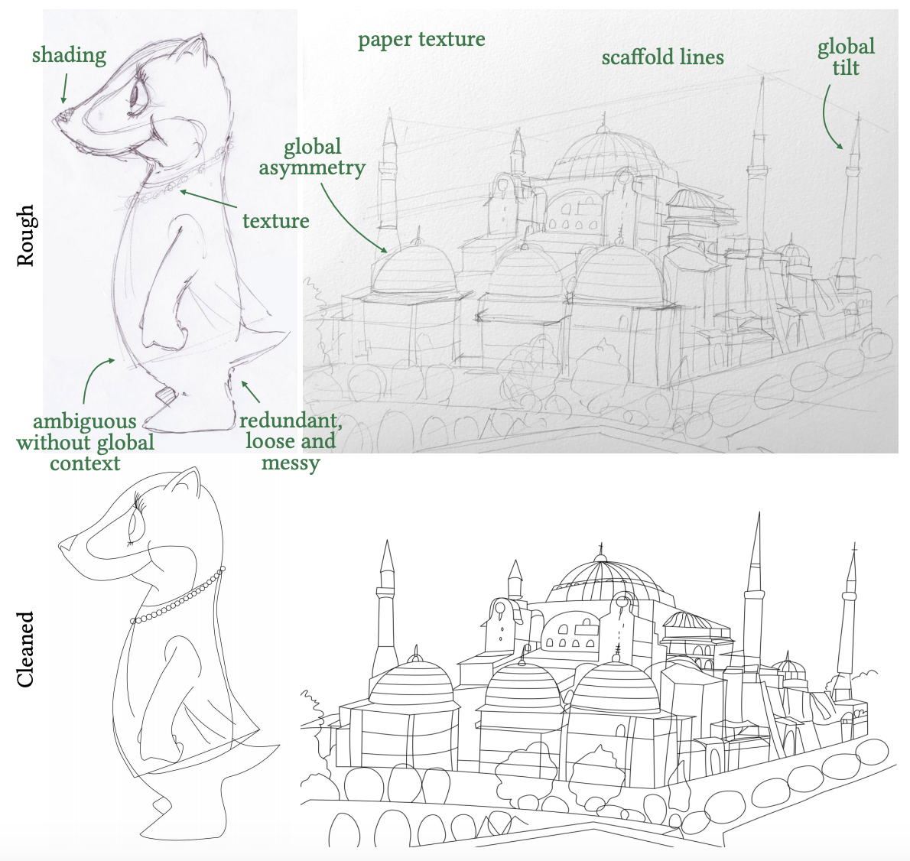
Sketches in the Wild
Which artifacts should be cleaned up by automatic algorithm?
Shading
Paper Texture
Scaffold lines
Tilt
Texture
Asymmetry
Ambiguous & Messy strokes
Image copyright: AP (CC-BY-SA-3.0), Jinho Jung (CC-BY-SA-2.0)
Notes:
Therefore, it is critical to give a clear statement of the problem: what should be the ideal cleaned sketch looked like?
This question could be divided into 2 sub-questions:
What information exist in a rough sketch that will eventually be remove or fixed?
As we have discussed in previous slide, physical artifacts, Non-smooth strokes and Global context should be considered first
But which of them should be solved by algorithm?
So break up those into more detailed groups, we propose in these groups
2.1 ambiguous, messy strokes texture stokes need to be cleaned up or fixed.
2.2 shading, hatching and scaffold lines, refining or cleaning is not necessary to them, cause they are temporal and will be remove or replaced eventually. So we just need to identify and separate them into different layers.
2.3 global context inconsistent, should be leave unchanged. Those information are usually decided by authors on the stage of early “structure level” or even on “conceptual level”. And it will be difficult to discriminate them from deliberately non-smooth strokes . So we assume the artists who draw these rough sketches are professional and are always correct at conceptual and structural design.

Slide 33
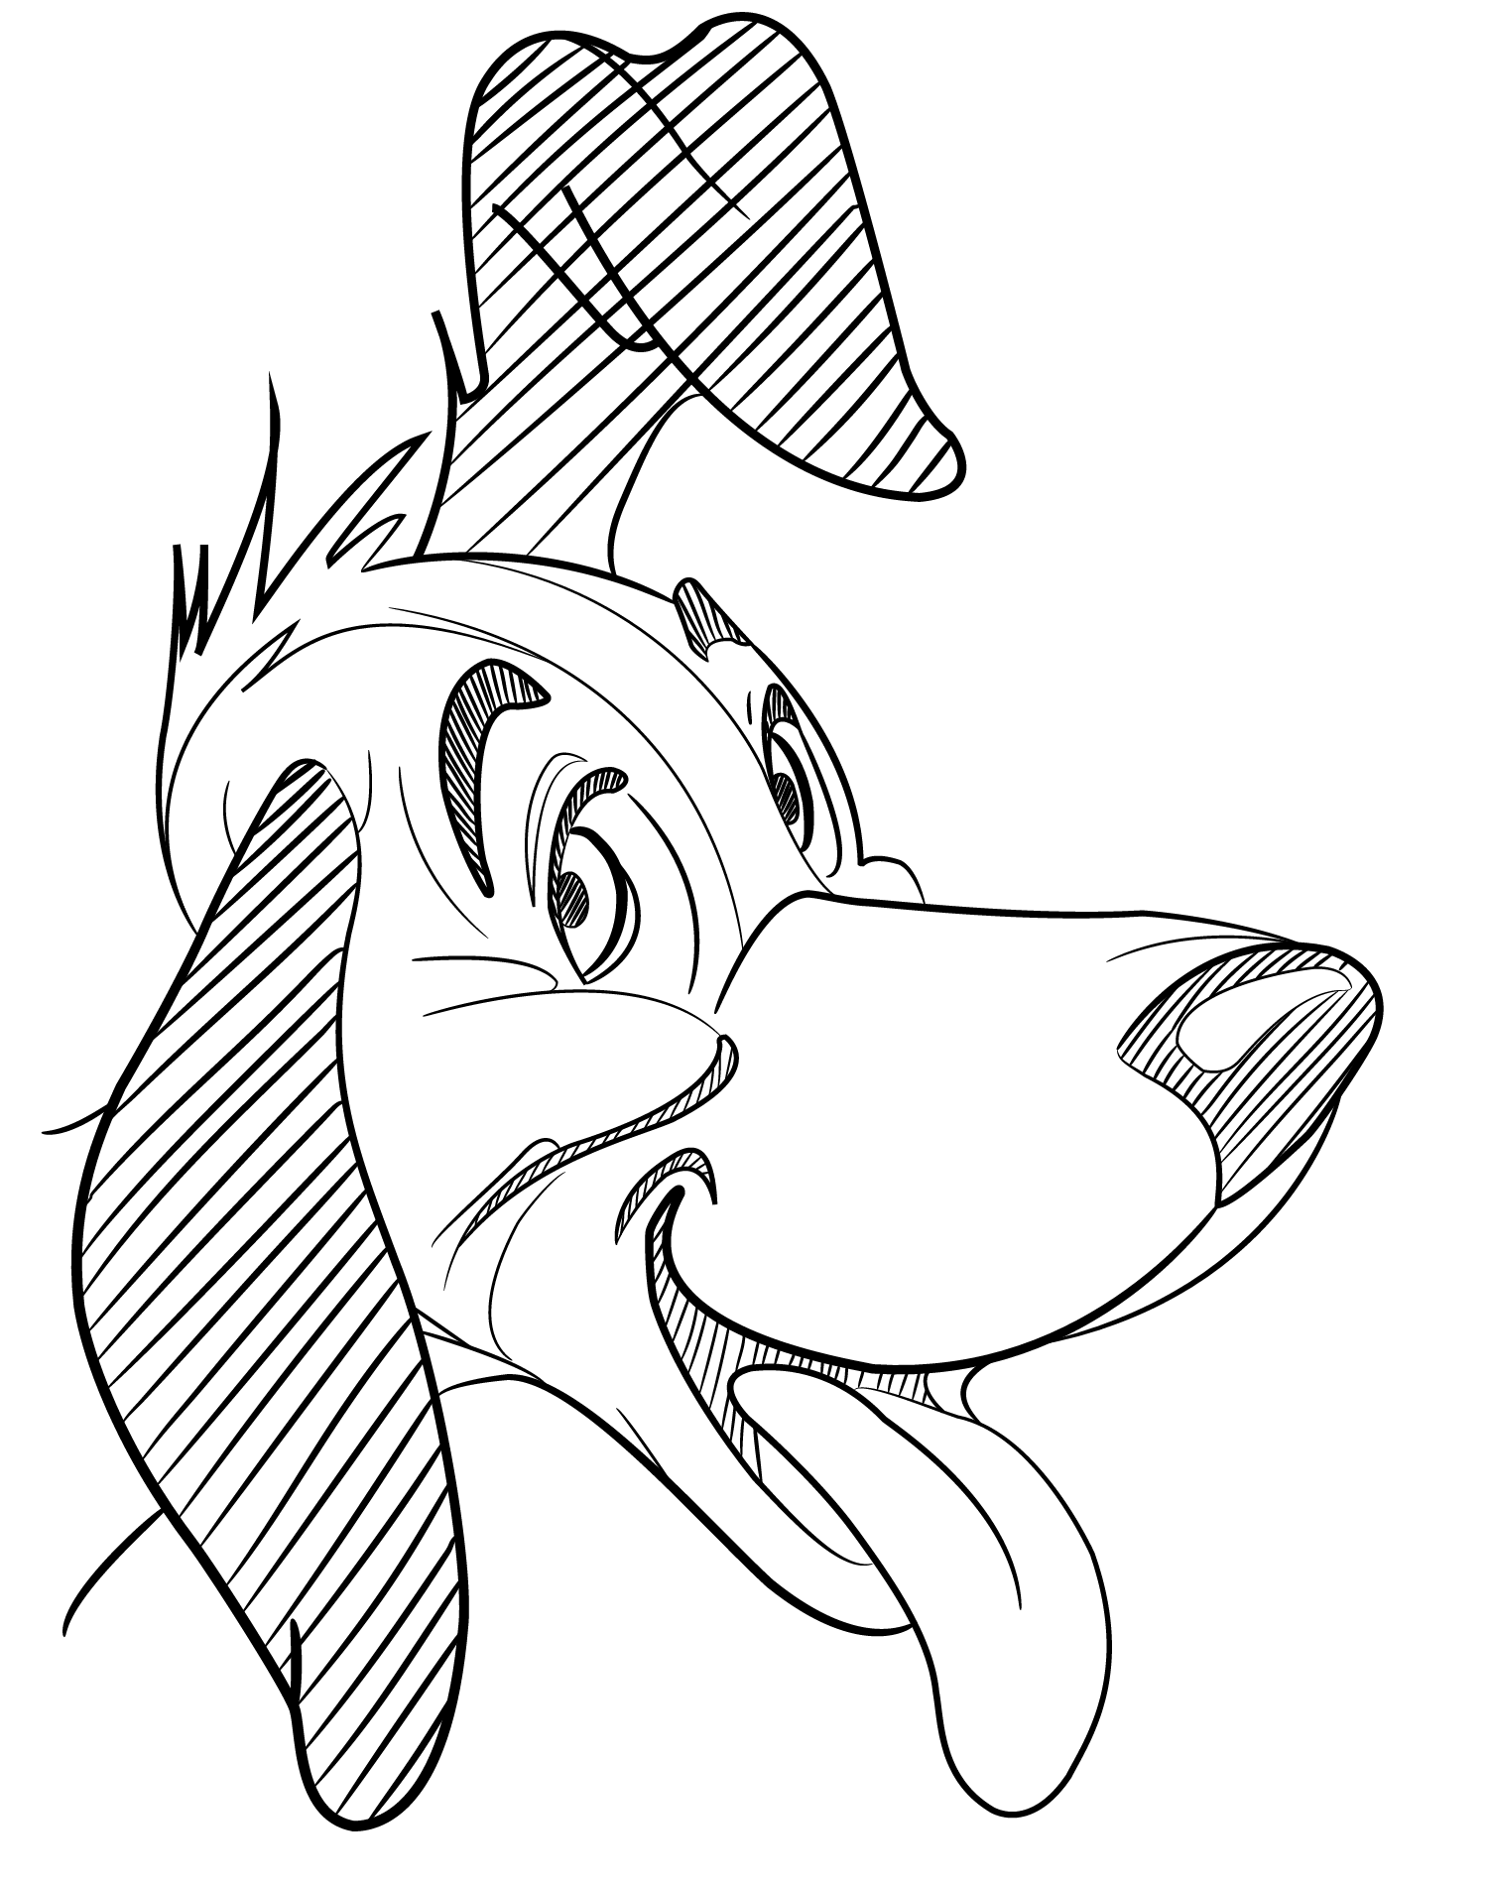
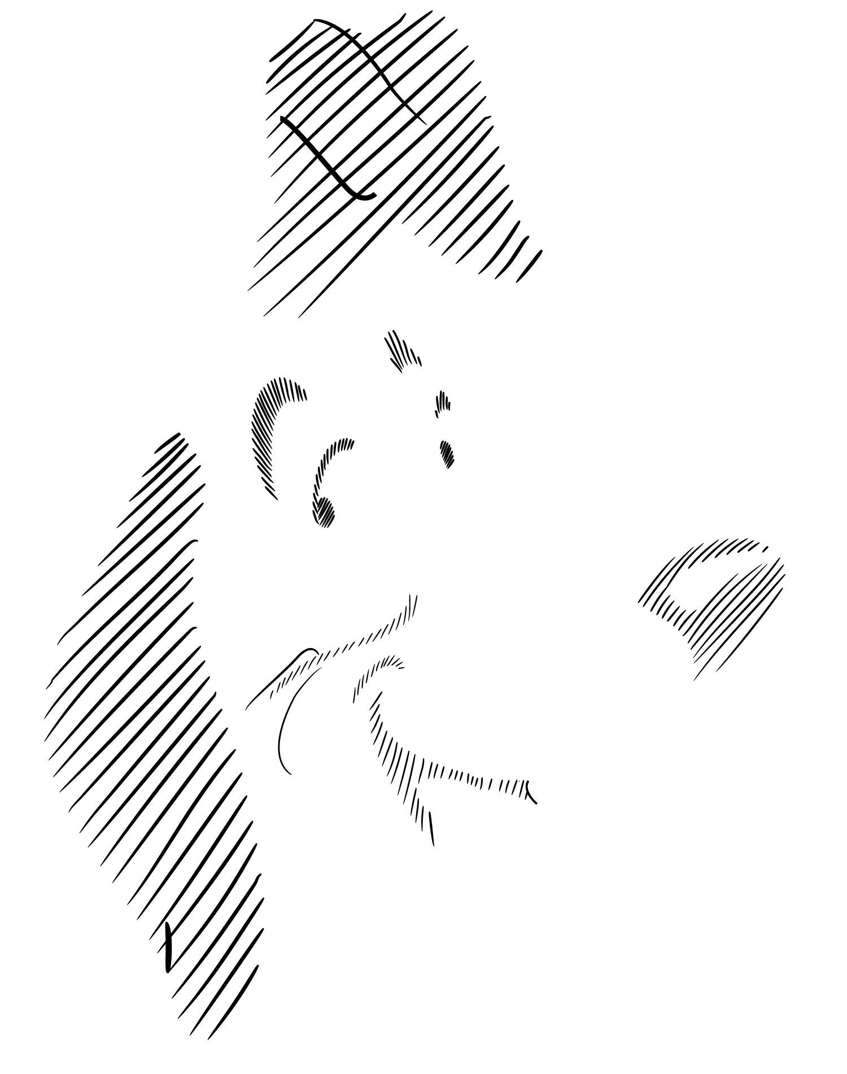
Problem Statement
Assessing algorithmic solution to sketch cleanup
Neaten and concise rough strokes
Identify and separate Non-shape strokes
Retain stroke thickness & color
Close junctions
No iteration
Global deformations are out of scope
Image copyrights: Explicit permission@Preston Blair
Notes:
With these in mind, we can express our problem statement as finding an algorithmic solution to sketch cleanup task. It should out put neat and concise clean strokes with precisely closed junctions and similar stroke thickness and color to original sketch. All non-shape strokes should be identified, separated and treated differently. At last, it can’t add details that are not exist in rough sketches.
On the other hand, global context should be identified as a problem with different scope.
At last, we also find that although cleanup a rough sketch as requirements above is easy for human, it is difficult to get every junction points closed precisely.

Slide 34
Dataset Creation
Genre (#curated/#total)
Architecture (12/26)
Freeform (33/86)
5 genres, 281 sketches
94% Creative Commons
39 authors
101 curated sketches, 3 ground truth per curated sketch
Curated sketches contain both raster & vector versions
40 baseline rough sketches
Rich tags (author, genre, stroke type, back ground, …)
Logo (12/29)
CC-BY-SA © Tinyhouse University
Fashion (11/40)
© Preston Blair
Design (33/40)
CC-BY-NC-2.0 ©
Anna a
CC-BY-2.0 © Jaguar MENA
CC-BY-SA-4.0 ©
Myriam Lasserre
Notes:
To be more specific, we collected a dataset with 281 rough sketches in which 101 are curated. The rough sketches are of 5 genres and created by 39 authors. Each curated sketches has 3-5 cleaned sketches by different professional artists, respectively. As you can see, the sketches on the right are examples in our dataset, each one represent one genre and numbers on top of them means curated sketch numbers and total numbers in that genre. 94% of them are of creative common licenses. We also try to bridge the gap between previous rough sketches in experiment and wild sketches by including 40 baseline rough sketches.

Slide 35
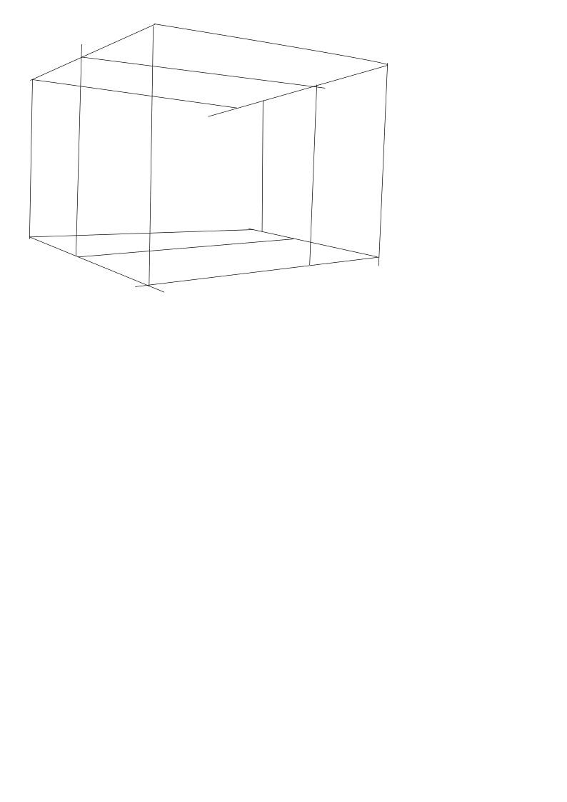
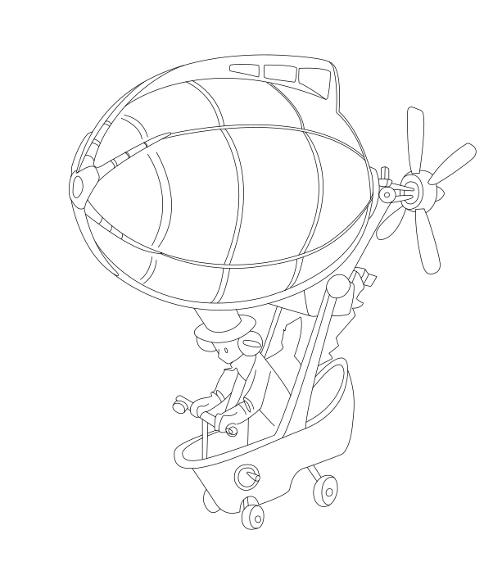
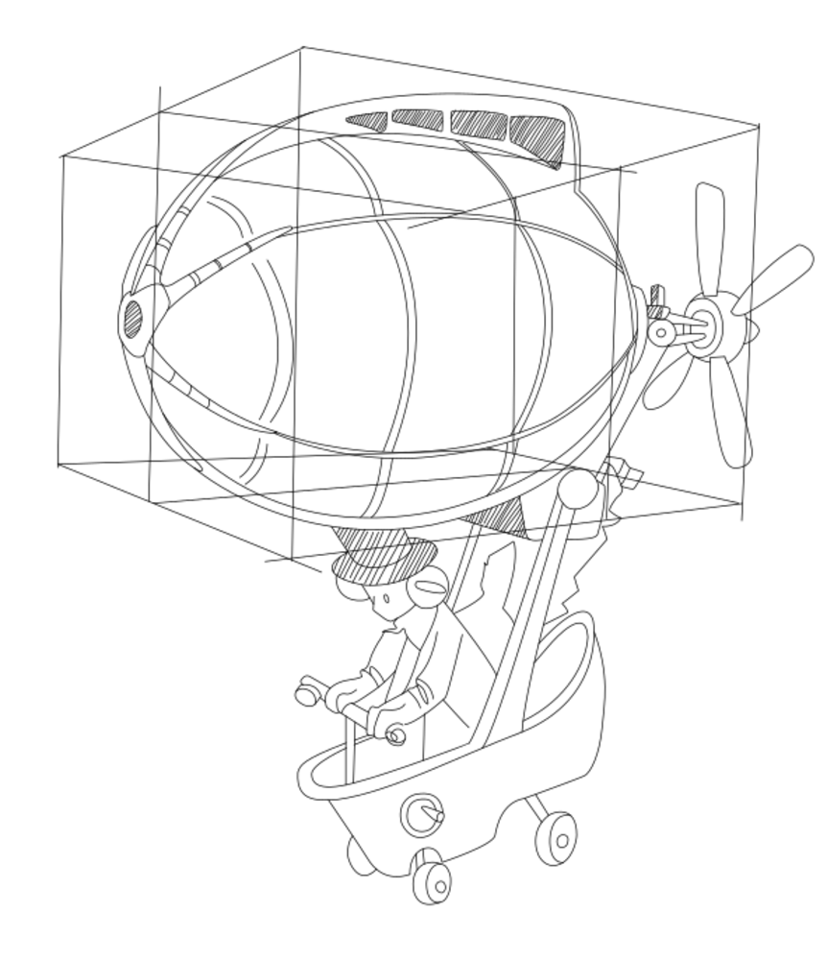
Ground Truth Creation
7 professional artists
Vector strokes, close junctions
No iteration
Make best guess
Layer separation
Uniform stroke color & width
Imperfect junctions
Upper image: ©David Revoy (CC BY 4.0), Lower image: ©Enrique Rosales
Notes:
We make our cleaned sketch with following rules:
No integration, which means we don’t want to add details or fixes that don’t exists in rough sketch
Make best guess, when it is difficult to infer clear stroke somewhere, we need to guess reasonable strokes without break no interaction rule
Non shape strokes should be move to different layers respectively.

Slide 36
Metrics
How well do algorithmically cleaned rough sketches match ground truth?
What is the quality of vector paths in the output?
How fast and reliable are the algorithms?
Speed?
Reliability?
Automatic cleaned sketch
Rough sketch
Similar to ground truth?
Sketch cleanup algorithms
Vector quality?
Image: ©Preston Blair
Notes:
After we get the manually cleaned sketches as ground truth, we consequently plan to find metrics to evaluate automatic cleaned sketches with those ground truth.
Considering the sketch cleanup algorithms may output raster or vector sketch, we need to consider metrics to evaluate sketch pair similarities in both domain.
For raster metric, we consider common metric as our point-to-point sketch distance
Including chamfer distance, precision and recall, Hausdorff distance, Intersection over union between automatic cleaned result and manually cleaned sketches.
But which distance should we use?
As the example shows, two sketches with different color represent automatic result and ground truth, respectively, then there will be typical 5 cases of the matching result. But only “perfect, nudge, dot” cases should have similar and relatively better results, since the automatic result are still complete. And the “dot only” case should has worse result. Only chamfer distance fits to our expectation.
Then consider the vector metric, we decided to compare the distribution of stroke length, junction point distance and number of open junctions between algorithmic results and vector ground truths.

Slide 37
Metrics
Similarity metrics
Chamfer distance (lower is better)
F-score (higher is better)
Hausdorff distance (lower is better)
IOU (higher is better)
Similar
Medium
Dissimilar
Notes:
After we get the manually cleaned sketches as ground truth, we consequently plan to find metrics to evaluate automatic cleaned sketches with those ground truth.
Considering the sketch cleanup algorithms may output raster or vector sketch, we need to consider metrics to evaluate sketch pair similarities in both domain.
For raster metric, we consider common metric as our point-to-point sketch distance
Including chamfer distance, precision and recall, Hausdorff distance, Intersection over union between automatic cleaned result and manually cleaned sketches.
But which distance should we use?
As the example shows, two sketches with different color represent automatic result and ground truth, respectively, then there will be typical 5 cases of the matching result. But only “perfect, nudge, dot” cases should have similar and relatively better results, since the automatic result are still complete. And the “dot only” case should has worse result. Only chamfer distance fits to our expectation.
Then consider the vector metric, we decided to compare the distribution of stroke length, junction point distance and number of open junctions between algorithmic results and vector ground truths.

Slide 38
Metrics
Vector quality
Stroke length
Vector algorithmically results
Image: ©Preston Blair
Notes:
After we get the manually cleaned sketches as ground truth, we consequently plan to find metrics to evaluate automatic cleaned sketches with those ground truth.
Considering the sketch cleanup algorithms may output raster or vector sketch, we need to consider metrics to evaluate sketch pair similarities in both domain.
For raster metric, we consider common metric as our point-to-point sketch distance
Including chamfer distance, precision and recall, Hausdorff distance, Intersection over union between automatic cleaned result and manually cleaned sketches.
But which distance should we use?
As the example shows, two sketches with different color represent automatic result and ground truth, respectively, then there will be typical 5 cases of the matching result. But only “perfect, nudge, dot” cases should have similar and relatively better results, since the automatic result are still complete. And the “dot only” case should has worse result. Only chamfer distance fits to our expectation.
Then consider the vector metric, we decided to compare the distribution of stroke length, junction point distance and number of open junctions between algorithmic results and vector ground truths.

Slide 39
Metrics
Vector quality
Stroke length
Junction quality
Vector algorithmically results
Image: ©Preston Blair
Notes:
After we get the manually cleaned sketches as ground truth, we consequently plan to find metrics to evaluate automatic cleaned sketches with those ground truth.
Considering the sketch cleanup algorithms may output raster or vector sketch, we need to consider metrics to evaluate sketch pair similarities in both domain.
For raster metric, we consider common metric as our point-to-point sketch distance
Including chamfer distance, precision and recall, Hausdorff distance, Intersection over union between automatic cleaned result and manually cleaned sketches.
But which distance should we use?
As the example shows, two sketches with different color represent automatic result and ground truth, respectively, then there will be typical 5 cases of the matching result. But only “perfect, nudge, dot” cases should have similar and relatively better results, since the automatic result are still complete. And the “dot only” case should has worse result. Only chamfer distance fits to our expectation.
Then consider the vector metric, we decided to compare the distribution of stroke length, junction point distance and number of open junctions between algorithmic results and vector ground truths.

Slide 40
Benchmark
Algorithms
Parameters
Based on author’s recommendation
A
B
C
D
Notes:
Next we could start our benchmark, we chose 7 recent sketch cleanup algorithms and made 4 groups depending on the input and output file format.
There are 4 algorithms that take raster sketch in and output vector cleaned sketch, 2 algorithms take raster input and have raster output as well, only 1 algorithm accept vector input and output vector cleaned sketch. We also created 2 pipelines from group b and c as raster in vector out.
All the running parameters are set as author’s recommendation
For each rough sketch, we thresholded and vectorized it in order to satisfy all algorithms input format requirement. Similar to the creation of cleaned sketch, we also separate the rough sketches into multiple layers with such as rough stroke, shadows, scaffold lines, and so on so forth. Additionally, we resized all thresholded and vectorized rough sketches to size of 1000 pixel or 500 pixel on its long edge.

Slide 41
Benchmark
Thresholded
Vectorized
Original
Data preparation
Sketch format: original, thresholded, and vectorized
Layer separation
Resolution: original, 1000, and 500 long edge pixels
1000-pixel
1000-pixel
500-pixel
500-pixel
Image: ©Patrick Murphy (CC-BY-2.0)
Notes:
Next we could start our benchmark, we chose 7 recent sketch cleanup algorithms and made 4 groups depending on the input and output file format.
There are 4 algorithms that take raster sketch in and output vector cleaned sketch, 2 algorithms take raster input and have raster output as well, only 1 algorithm accept vector input and output vector cleaned sketch. We also created 2 pipelines from group b and c as raster in vector out.
All the running parameters are set as author’s recommendation
For each rough sketch, we thresholded and vectorized it in order to satisfy all algorithms input format requirement. Similar to the creation of cleaned sketch, we also separate the rough sketches into multiple layers with such as rough stroke, shadows, scaffold lines, and so on so forth. Additionally, we resized all thresholded and vectorized rough sketches to size of 1000 pixel or 500 pixel on its long edge.

Slide 42
Benchmark
How well do algorithmically cleaned rough sketches match ground truth?
Fidelity vs Simplicity
Notes:
Do we really need to show and explain all evaluation chart to audiences?
Those charts contain rich but loose information, different people may want to know different information from it, so we need to tell informations that could be interesting to all people.
==========
Then we carry out our evaluation on 4 aspects:
We use chamfer distance to evaluate raster sketch by the pixel distance, and evaluate vector sketch by counting its the stroke length, junction distance and the number of open endpoints. Then we also recorded the running time and failure rate of each algorithm. We encourage the audience to look our paper or benchmark website for more details

Slide 43
Benchmark
Vector quality
Stroke Length
StrokeAggregator
Ground Truth
Notes:
Do we really need to show and explain all evaluation chart to audiences?
Those charts contain rich but loose information, different people may want to know different information from it, so we need to tell informations that could be interesting to all people.
==========
Then we carry out our evaluation on 4 aspects:
We use chamfer distance to evaluate raster sketch by the pixel distance, and evaluate vector sketch by counting its the stroke length, junction distance and the number of open endpoints. Then we also recorded the running time and failure rate of each algorithm. We encourage the audience to look our paper or benchmark website for more details

Slide 44
Benchmark
Vector quality
Junction Distances
Open Endpoints
Notes:
Do we really need to show and explain all evaluation chart to audiences?
Those charts contain rich but loose information, different people may want to know different information from it, so we need to tell informations that could be interesting to all people.
==========
Then we carry out our evaluation on 4 aspects:
We use chamfer distance to evaluate raster sketch by the pixel distance, and evaluate vector sketch by counting its the stroke length, junction distance and the number of open endpoints. Then we also recorded the running time and failure rate of each algorithm. We encourage the audience to look our paper or benchmark website for more details

Slide 45
Benchmark
Failure Rate
Running Time
Notes:
Do we really need to show and explain all evaluation chart to audiences?
Those charts contain rich but loose information, different people may want to know different information from it, so we need to tell informations that could be interesting to all people.
==========
Then we carry out our evaluation on 4 aspects:
We use chamfer distance to evaluate raster sketch by the pixel distance, and evaluate vector sketch by counting its the stroke length, junction distance and the number of open endpoints. Then we also recorded the running time and failure rate of each algorithm. We encourage the audience to look our paper or benchmark website for more details

Slide 46
Benchmark
Ambiguity
How much do humans agree on the cleaned sketch?
Similarity between the multiple ground truths
Rough Sketch
Multiple Ground Truths
Notes:
We also investigated the way of describing rough sketches.
We used the average of pixel distances between ground truths as ambiguity to describe how the agree with each other when cleaning that rough sketch. And we use the ration of pixel numbers between cleaned sketch and rough sketch as messiness to describe how many informations are need to be removed for a rough sketch
Usually high ambiguity will cause high messiness, but the opposite is now always true.

Slide 47
Benchmark
Messiness
How much non-essential information does the input sketch contain?
The fraction of covered pixels removed during cleanup
Rough Sketch
Multiple Ground Truths
Image: ©Trip Ivey (CC-BY-4.0)
Notes:
We also investigated the way of describing rough sketches.
We used the average of pixel distances between ground truths as ambiguity to describe how the agree with each other when cleaning that rough sketch. And we use the ration of pixel numbers between cleaned sketch and rough sketch as messiness to describe how many informations are need to be removed for a rough sketch
Usually high ambiguity will cause high messiness, but the opposite is now always true.

Slide 48
Benchmark
Ambiguity vs. Messiness
Rough sketch
Rough Sketch
Multiple Ground Truths
Image: ©Alexander Strugach (CC-BY-2.0)
Notes:
We also investigated the way of describing rough sketches.
We used the average of pixel distances between ground truths as ambiguity to describe how the agree with each other when cleaning that rough sketch. And we use the ration of pixel numbers between cleaned sketch and rough sketch as messiness to describe how many informations are need to be removed for a rough sketch
Usually high ambiguity will cause high messiness, but the opposite is now always true.

Slide 49
Algorithm characteristics
Resolution dependence
Image: ©Enrique Rosales
Notes:
We also captured many open problems by analyzing the metric of results of all the algorithms:
Such as some algorithms are sensitive to the input sketch’s resolution, some algorithms prefer a complete close on junctions, some algorithms need a fine-tuned parameter for each rough sketch, and some algorithms only works well on low messiness sketches.

Slide 50
Algorithm characteristics
Fidelity vs Simplicity
Gap sensitivity
Image: ©Enrique Rosales
Notes:
We also captured many open problems by analyzing the metric of results of all the algorithms:
Such as some algorithms are sensitive to the input sketch’s resolution, some algorithms prefer a complete close on junctions, some algorithms need a fine-tuned parameter for each rough sketch, and some algorithms only works well on low messiness sketches.

Slide 51
Algorithm characteristics
Delaunay Triangulation
Parameter sensitivity
Image: ©Hugo Fonseca (CC-BY-NC-SA-3.0)
Notes:
We also captured many open problems by analyzing the metric of results of all the algorithms:
Such as some algorithms are sensitive to the input sketch’s resolution, some algorithms prefer a complete close on junctions, some algorithms need a fine-tuned parameter for each rough sketch, and some algorithms only works well on low messiness sketches.

Slide 52
Algorithm characteristics
PolyVector & TopologyDriven
Messiness sensitivity
Notes:
We also captured many open problems by analyzing the metric of results of all the algorithms:
Such as some algorithms are sensitive to the input sketch’s resolution, some algorithms prefer a complete close on junctions, some algorithms need a fine-tuned parameter for each rough sketch, and some algorithms only works well on low messiness sketches.

Slide 53
Open Problems
Algorithm robustness
Vectorized - all stroke, 1000px
Vectorized - shape stroke, 1000px
Rough
Algorithmic output
Algorithmic output
Failed
Thresholded
Thresholded - 1000px
Algorithmic output
Thresholded - 500px
Algorithmic output
Failed

Slide 54
Open Problems
Algorithm robustness
Resolution dependence
Rough
Algorithmic result - 1000px
Algorithmic result - 500px
Image: ©AP (CC-BY-SA 3.0)

Slide 55
Open Problems
Algorithm robustness
Resolution dependence
Physical artifacts removal
Rough
Algorithmic result
Ground truth
Image: ©Tinyhouse University (CC-BY-SA)

Slide 56
Open Problems
Rough
Algorithm robustness
Resolution dependence
Physical artifacts removal
Non-shape stroke separation
Ground Truth - shape stroke
Ground Truth - shading & texture
Algorithmic result
Image: ©David Revoy (CC BY 4.0)

Slide 57
Open Problems
Algorithmic result
Algorithm robustness
Resolution dependence
Physical artifacts removal
Non-shape stroke separation
Stroke thickness and color preservation
Rough
Idea ground truth
Image: ©Preston Blair

Slide 58
Limitations and Future Work
Simple metrics
Imperfect topology of vector ground truth
Small dataset
Narrowly defined problem
Rough Sketch
Artist’s Revision
Our Ground Truth
Upper image: Anastasia Majzhegisheva (CC-BY-4.0), Lower image: Jinho Jung (CC-BY-SA-2.0)
Notes:
Although we try to push ourself to the answer of those questions we have asked, there are two major limitations in our work:
We just used simple and elementary metrics, which may not fully explore the characteristics of automatic results and rough sketches themselves.
We narrowed our problem definition, the ground truth we created may not look same as the sketch cleaned by its original author, as the example on the right shows. Therefore, tasks that out of sketch cleanup may be benefited less from our dataset.

Slide 59
Future Work
Different algorithms can have different goals
End-to-End Evaluation
Junction Snapping
Neatness Gap
BetweenIT [Whited et al 2010]
True2Form [Xu et al 2014]
CrossShade [C. Shao et al 2012]
The design squiggle: Damien Newman (CC-BY-ND 3.0)
Notes:
But the second limitation also leads to more discussions:
Look back to the curve we discussed at the beginning, different algorithms may prefer rough sketches which are created at different stage. And if we put all the algorithm’s preferred rough sketch on this curve. They might have different start points to the end.
But when all algorithms tries to get to the cleaned sketch at the end point, do they really excepted to get the same result? Or probably should they focus on different sub-task and be evaluated differently?

Slide 60
Our Contributions
A dataset of 281 sketches from the wild
Ground truth for a curated subset of 101 sketches along with 40 sketches from previous work
Computational metrics for evaluating sketch cleanup algorithms
An analysis of cleanup performance of 7 algorithms and 2 pipelines
A clear problem statement for sketch cleanup
Notes:
So aiming to those two problem statements, our contributions are:
We analyzed the characteristics of wild sketches then build up a dataset with featured rough sketches with their manually cleaned sketch as ground truth.
Then we proposed a computational evaluation metrics to generally give a fair comparison of all the state-of-the-art sketch cleanup algorithms.
At last we summarize all evaluation result into a benchmark and identified open problems for those algorithms and this research topic.

Slide 61
Co-Authors
Yotam Gingold
David Vanderhaeghe

Slide 62
Thank You for Listening
Browse, download, and run our benchmark on your algorithm:
https://cragl.cs.gmu.edu/sketchbench/
Notes:
Our evaluation and benchmark generation code are all available on GitHub, they are easy to run, please go to our project web page and have a try!

